Slide 1
A Random Forest-Based Commission Error Filter for LANDFIRE Disturbance Mapping
Sanath Sathyachandran Kumar^{1*}, Brian Tolk², Ray Dittmeier², Joshua J Picotte¹, Inga La Puma ², Birgit Peterson³, Timothy D. Hatten³
.
¹ASRC Federal Data Solutions contractor to United States Geological Survey (USGS) Earth Resources Observation and Science (EROS) Center, Sioux Falls, SD 57198, USA.
²KBR contractor to USGS EROS Center, Sioux Falls, SD 57198, USA.
³ EROS Center, Sioux Falls, SD 57198, USA.
This work was performed under the US. Geological Survey (USGS) SSSC contract# 140G0119C0001 and TSSC contract# 140G0121D0001.
October 25 2022

Slide 2
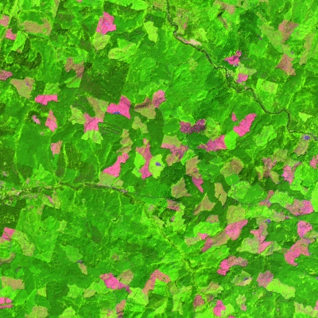
Change detection 101
Considers two scenes from consecutive years and anniversary dates
Disturbances do not always have spectral contrast
All spectral differences are not necessarily vegetation disturbances
Machine detection requires a threshold
Any “threshold” will have associated omission and commission error
Notes:
Talk about the definition of change using Brian’s talk (Mag of change/sev.)
LANDFIRE’s disturbance products reflect abrupt inter-annual changes originating from either human or natural incidents but also include agency-submitted “Events” that capture vegetation/fuel treatment activity

Slide 3
Automated change detection challenges
“The Holy Grail of change detection is still total automation and high accuracy. However, methods that reduce labor costs while maintaining consistency and accuracy are needed.”
Loveland, T., Sohl, T., Stehman, S., Gallant, A., Sayler, K., & Napton, D. (2002). A Strategy for Estimating the Rates of Recent United States Land-Cover Changes. Photogrammetric Engineering & Remote Sensing, 68, 1091-1099

Slide 4
Automated change detection challenges
Errors of omission and commission are inevitable in RS change detection
Human perception is still superior compared to computers. But the gap is narrowing.
Can elements of human perception and analysis be exploited ?
Learning
Spatial context

Slide 5
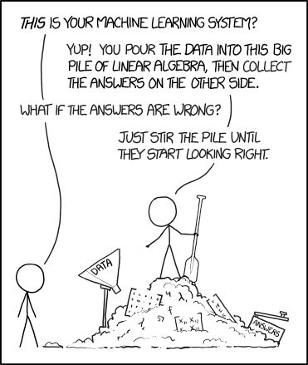
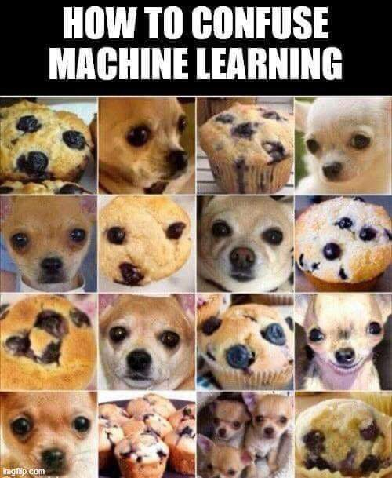
Machine learning
Training a machine is not easy !
Can you count these?
https://medium.com/@ahffank/solving-the-famous-problem-of-puppy-vs-muffin-using-a-simple-web-application-on-google-app-a3264e2be49c
https://www.reddit.com/r/ProgrammerHumor/comments/kz7e18/supervised_machine_learning/
https://dmcommunity.org/2017/09/01/machine-learning-humor/

Slide 6
Machine learning
Training a machine is not easy !
Needs high quality and diverse training data
We have our analyst-reviewed data
Predictor variables including spatial contexts
Notes:
But how to parameterize spatial context ?

Slide 7
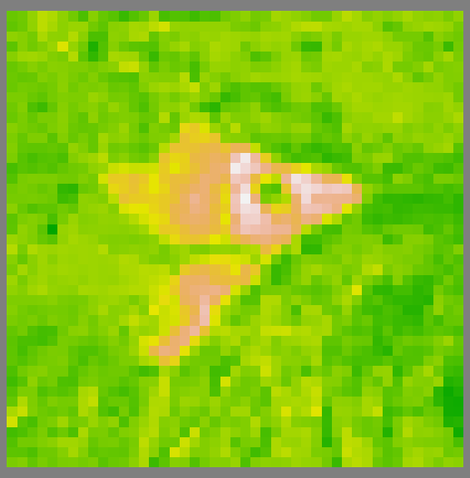
Spatial context parameterization
Spatially Adaptable Filter for Error Reduction (SAFER)
a) Spatial Reference image

Slide 8
Spatial context parameterization
Spatially Adaptable Filter for Error Reduction (SAFER)
a) Spatial Reference image
b) Disturbance (k)

Slide 9
Spatial context parameterization
Spatially Adaptable Filter for Error Reduction (SAFER)
a) Spatial Reference image
b) Disturbance (k)
c) Rings (j=1)
d) Rings (j=2)
$${Spatial Change probabilities Z}_{i,k}^{Reference} SCZ= {\left({Reference}_{i,k}− μ_{k,j}^{Reference}\right)}/{σ_{k,j}^{Reference}}$$

Slide 10
Spatial context parameterization
Spatially Adaptable Filter for Error Reduction (SAFER)
e) Eq 1. SCZ values
SCZ > 3
2 < SCZ ≤ 3
1 < SCZ ≤ 2
a) Spatial Reference image
b) Disturbance (k)
c) Rings (j=1)
d) Rings (j=2)

Slide 11
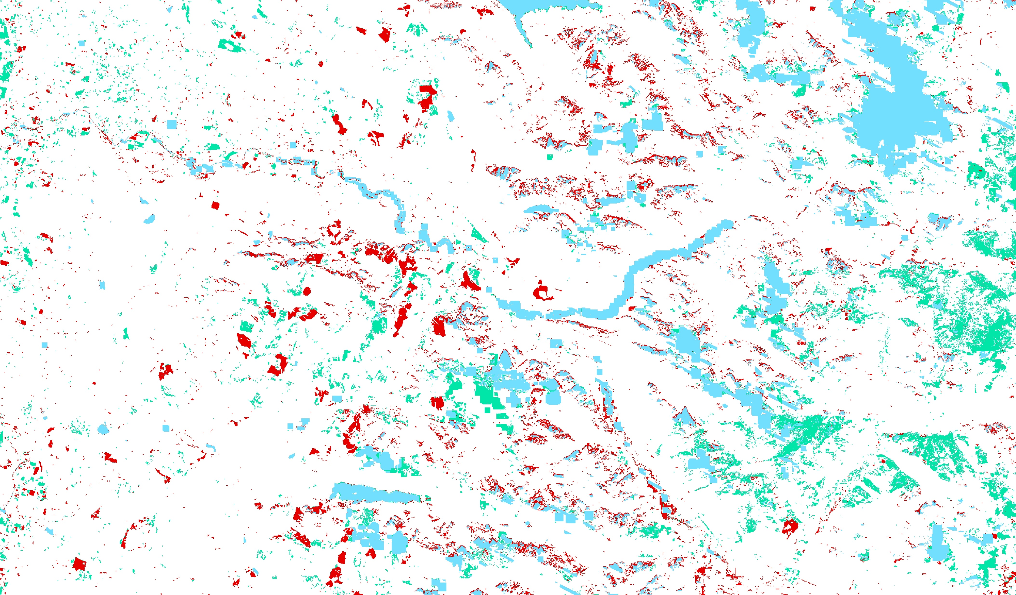
Spatial context parameterization
Biomass Increase
Biomass Decrease
Water

Slide 12
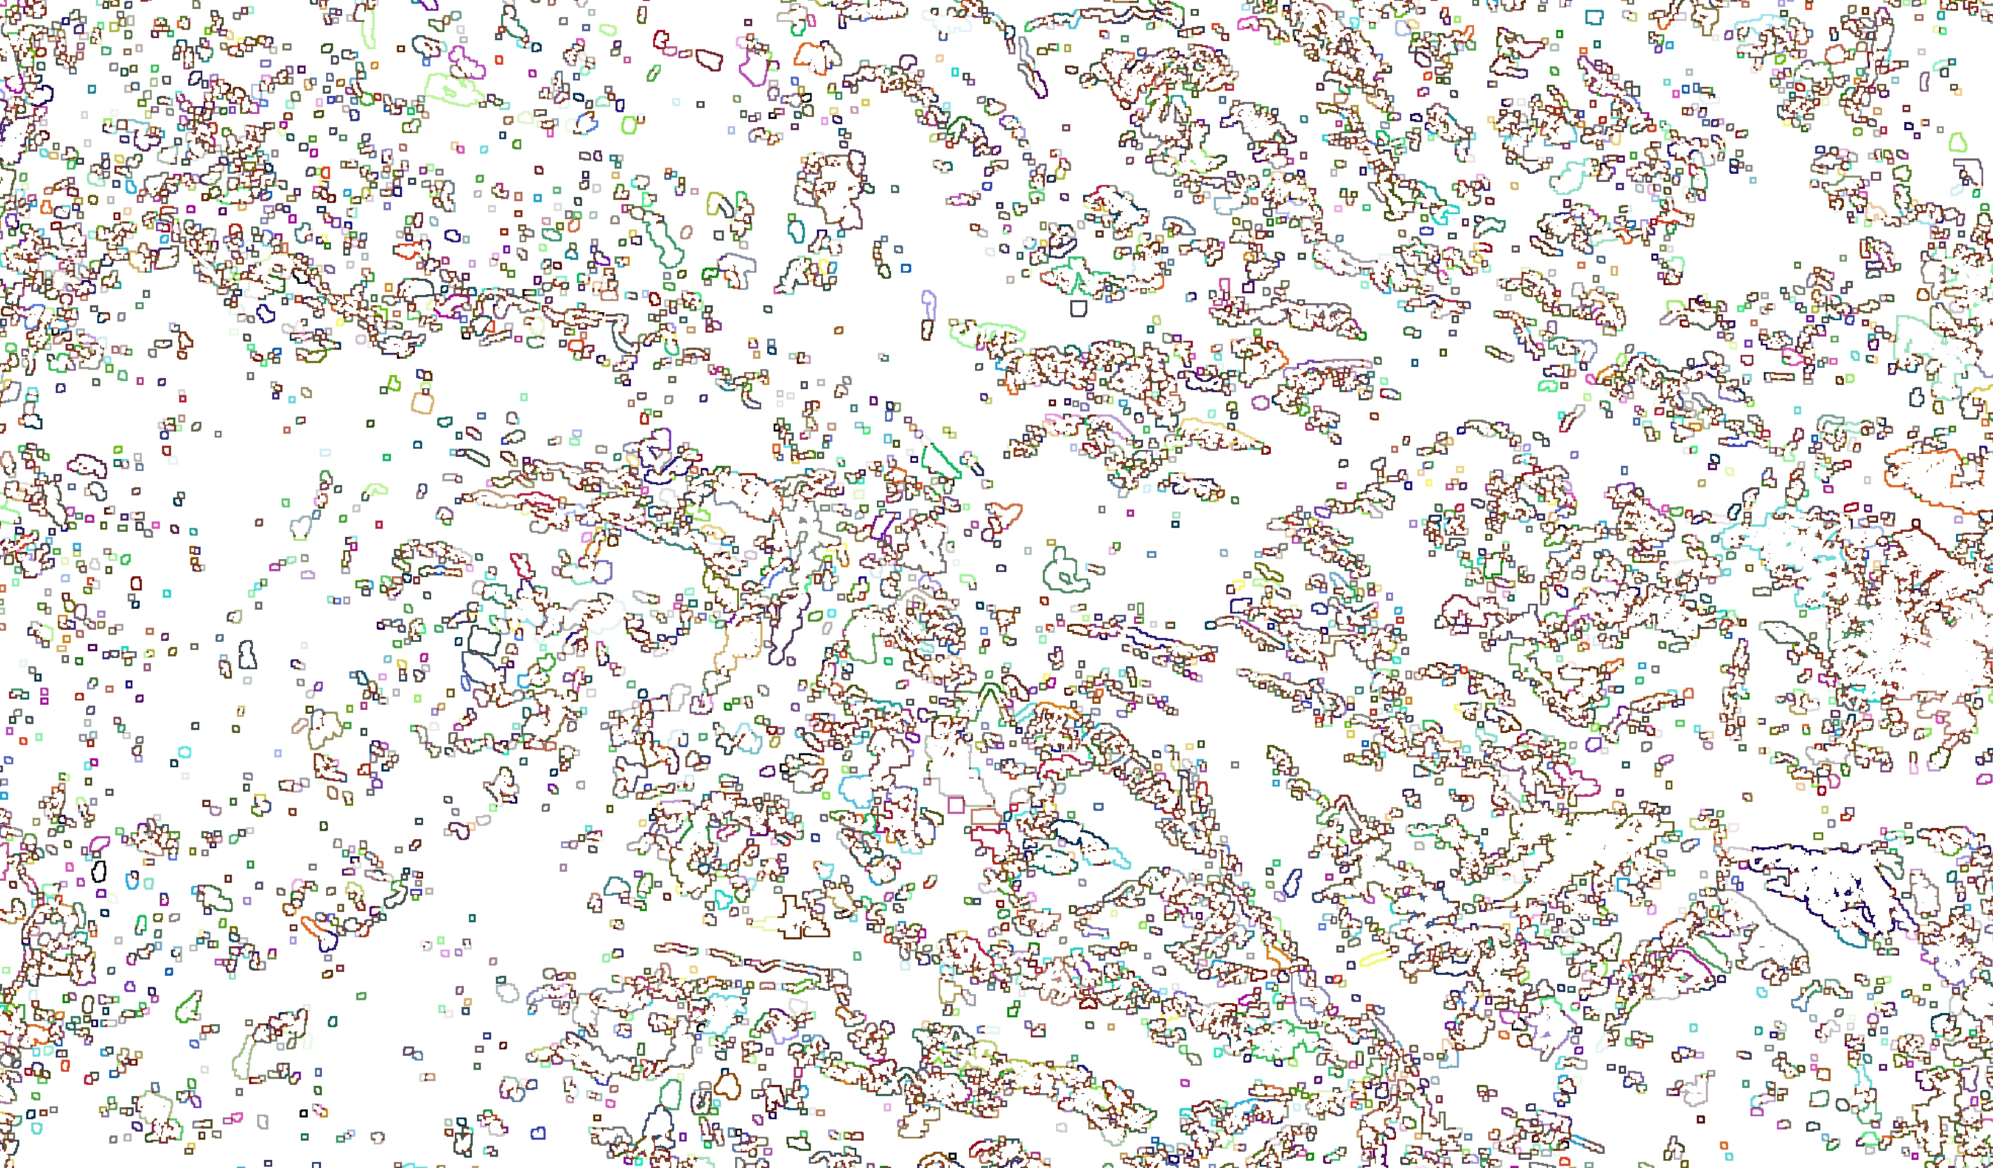
Spatial context parameterization

Slide 13
Spatial context parameterization
Probabilities
Z scores between ring statistics and each pixel in disturbance candidate
Darker values indicates larger differences
So how to define the “cutoff”?
Use Machine learning

Slide 14
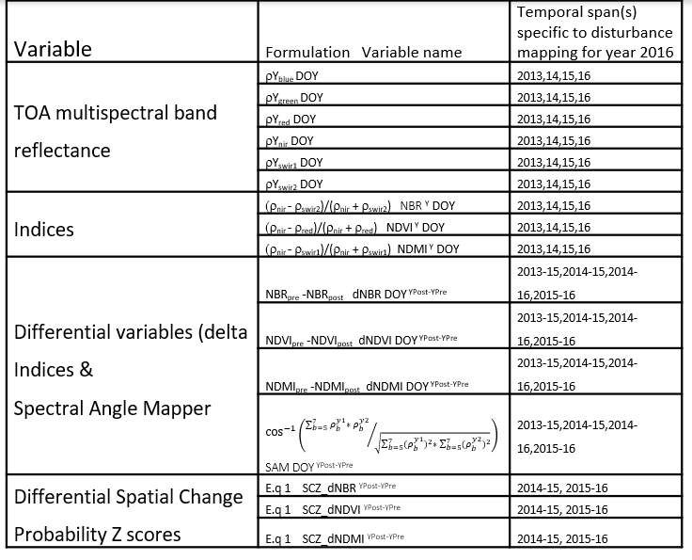
Spatially Adaptive Filter for Error Reduction (SAFER)
Predictor variables
3 years* 6 band TOA/SR * 2 seasons
3 years* 3 Indices* 2 seasons
2 image pairs * 4 delta indices* 2 seasons
1 image pair* 3 Z scores* 2 seasons
= 73 predictor variables.

Slide 15
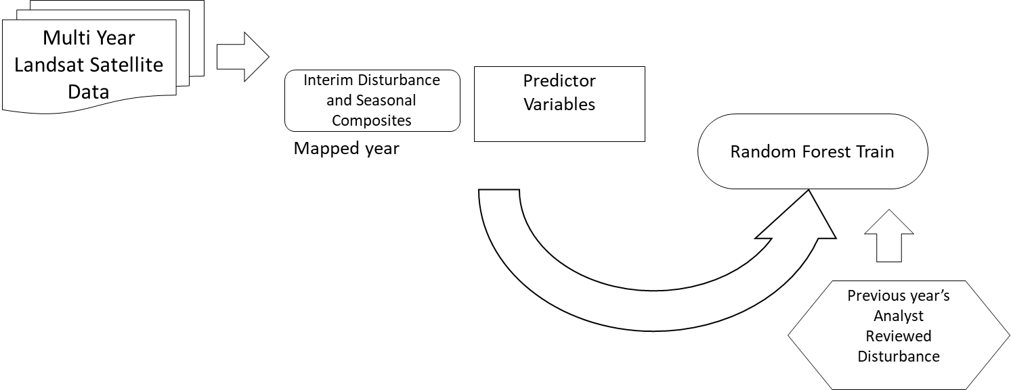
SAFER flow chart

Slide 16
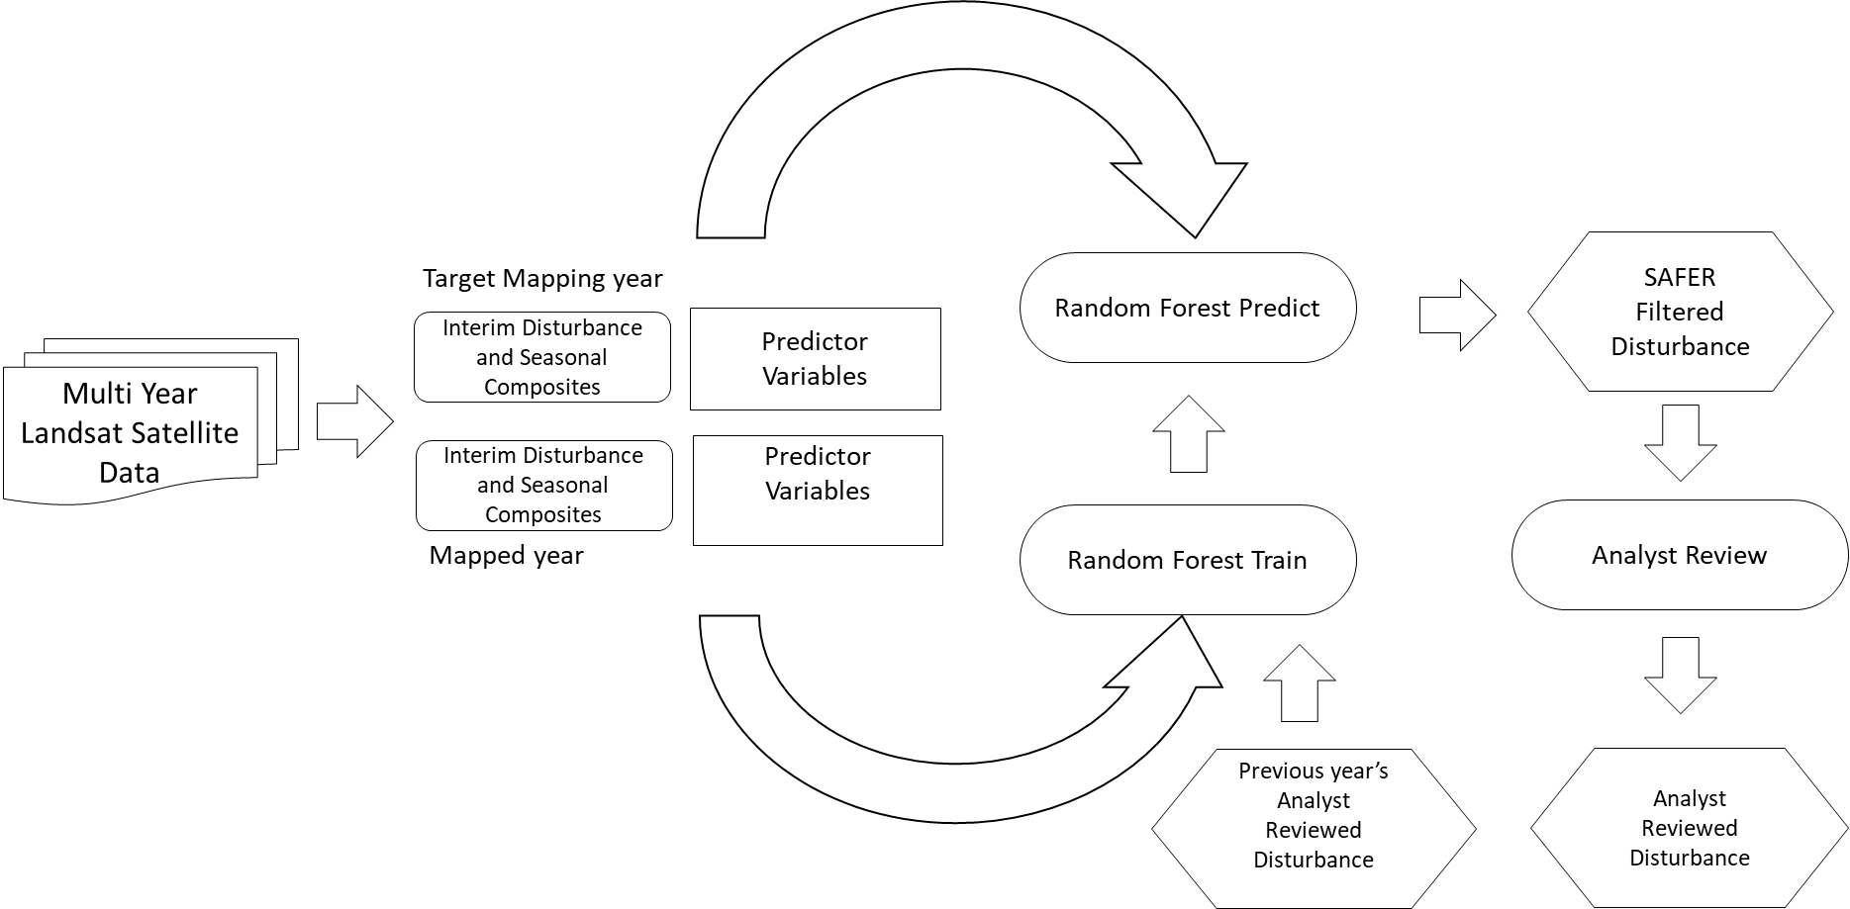
SAFER flow chart

Slide 17
SAFER flow chart

Slide 18
SAFER flow chart

Slide 19
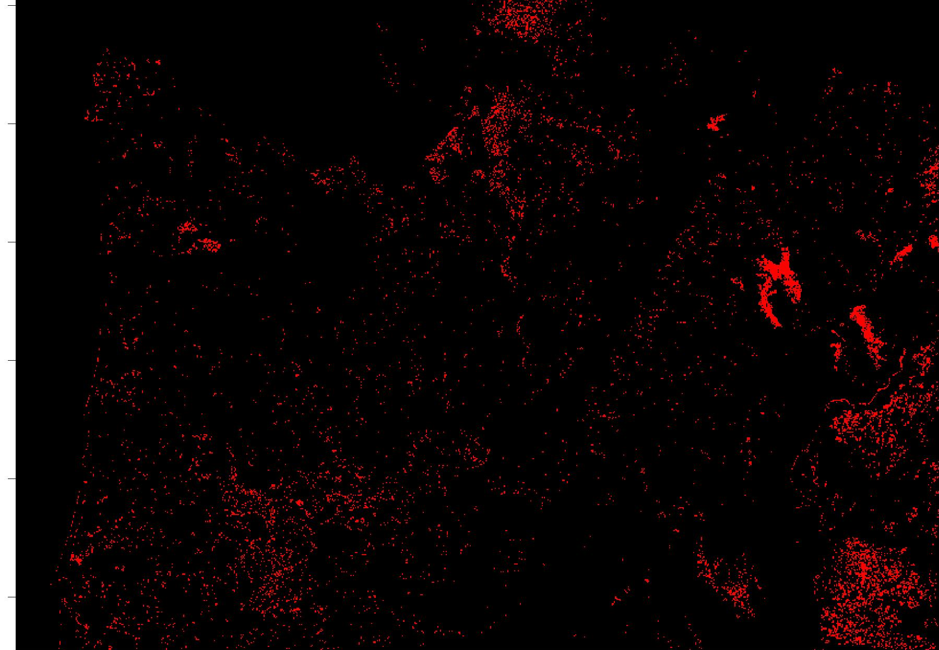
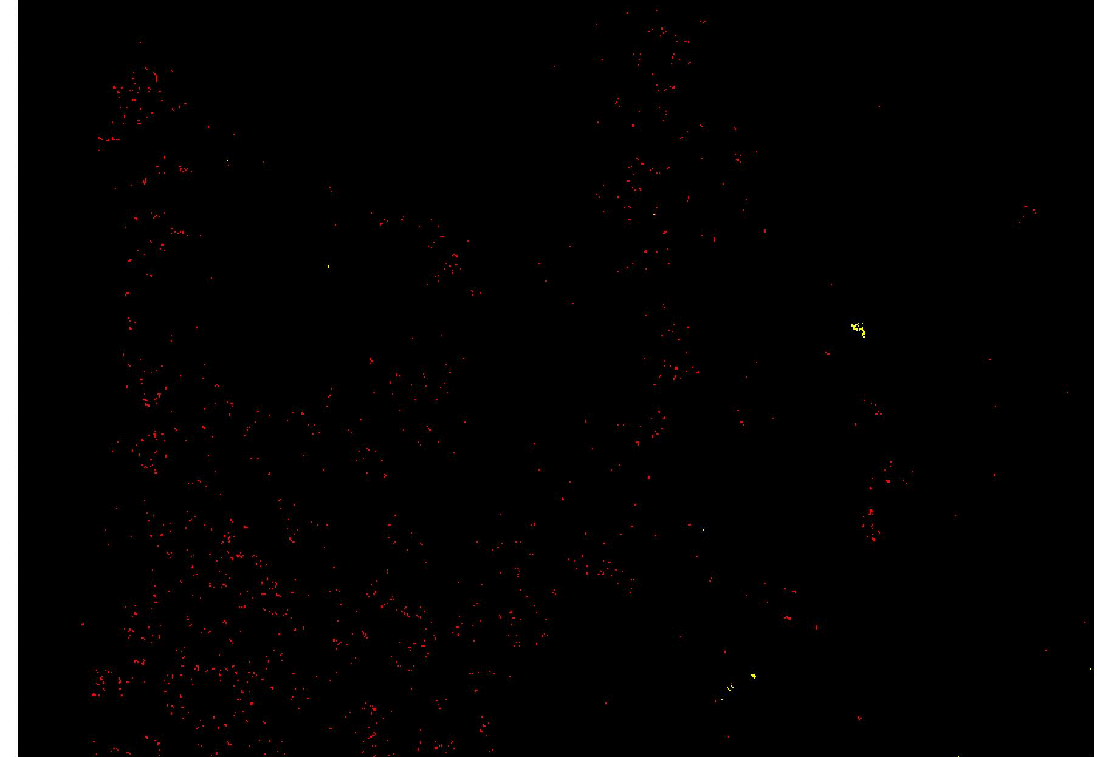
SAFER results
LF tile r01c02
SAFER results vs. analyst-reviewed data
SAFER has potential to reduce
commission errors ~ 70- 99%
analyst effort by over 96%.

Slide 20
SAFER results
dNBR
Detections
dNBR
Detections
Analysts are important
Humans “see” a road
Not everything is fully automated, but we have come a long way
Analyst-reviewed data
SAFER outputs
Analyst-reviewed data
SAFER outputs

Slide 21
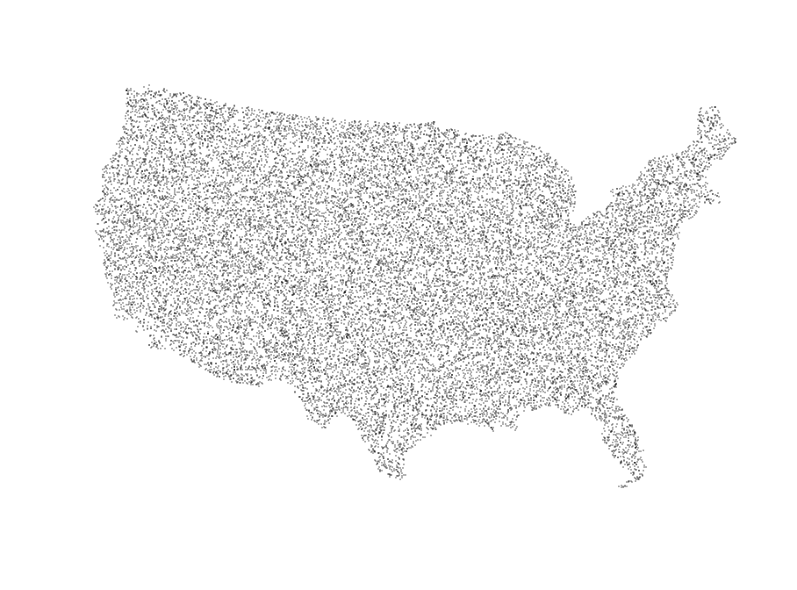
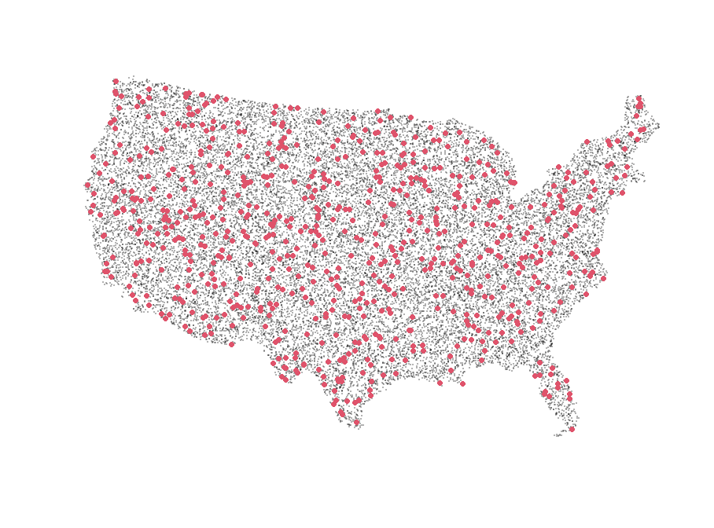
So how are we doing?
2015 change
LCMAP reference data base (1984- 2018)
Expert opinion using 255×255-pixel single-date Landsat subsets from 1984 to 2018 growing season images, which are displayed in sequence
~25000 data points through out CONUS per year (Jan 1- dec 31)
Interpreter agreement was 88%+ overall ranging from 46% + (Disturbed)
Change: Mechanical, Harvest, Fire, Structural Decline and Wind
No change: Stable & Growth

Slide 22
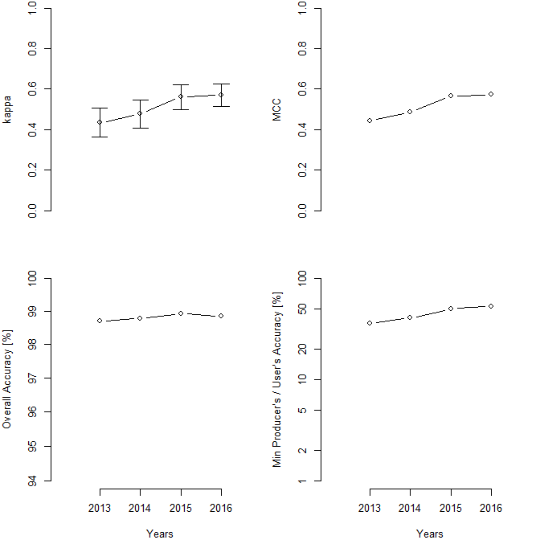
So how are we doing?
kappa
MCC
LF Reporting period is centered around DOY 175 & DOY 250
Comparison on annual time steps
LF reference reporting period is 1- 365
Some mismatch expected.
Median CONUS wide LF product accuracy is 98.9% over all with 0.47 MCC
Min accuracy
(User’s or Producers’)
Overall Accuracy
Notes:
We do a review of each other's work, the reviewer sends a list of items they feel are incorrect. The mapper then looks at the reviewer's response and has the ultimate decision whether to accept or reject their advice. Usually it's accepted but if there are questions then they reach out. It has a lot to do with experience. First time mappers need a lot of help, but as their experience grows there is usually less to fix. We haven't done a statistical comparison.

Slide 23
Conclusions
Errors of commission come at the cost of omissions
Issue stems from “fixed” thresholds that may not be valid for all regions/time
Spatial information can be useful
Machine learning has potential
SAFER effectively
removes 70-99% false detections,
SAFER increases accuracy metrics in all cases, provides a good head start for the analyst
decreases analyst effort by over 96%
Median CONUS wide LF product accuracy is 98.9% over all with 0.47 MCC
Scope for improvement exists and we are aiming for annual updates. Stay tuned!

Slide 24
Questions, comments
&
suggestions
There were 10 puppies and 14 muffins
This work was performed under the US. Geological Survey (USGS) SSSC contract# 140G0119C0001 and TSSC contract# 140G0121D0001.

