Slide 1


The LANDFIRE image-based annual prototype:
Detailed annual updates to vegetation maps for the US using machine learning
Daryn Dockter*, LANDFIRE Vegetation Mapping Lead
Inga La Puma*, LANDFIRE Technical Lead – presenting
Josh Picotte **, LANDFIRE Scientist
*KBR, and **ASC, contractors to the U.S. Geological Survey (USGS) Center for Earth Resources
Observation and Science (EROS), Sioux Falls, South Dakota
Work performed under USGS contract 140G0121D0001

Slide 2
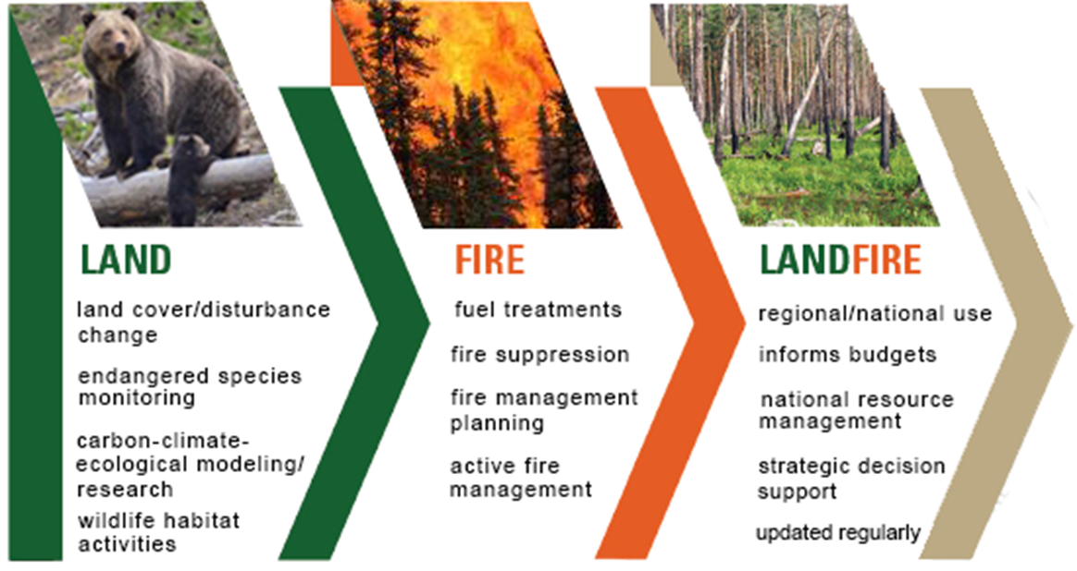
LANDFIRE Overview
Notes:
In support of National Fire Plan, Cohesive Strategy. Chartered by: Wildland Fire Leadership Council in 2004
National mapping program funded by USFS and DOI- office of wildland fire, TNC partners, and USGS runs the contract

Slide 3
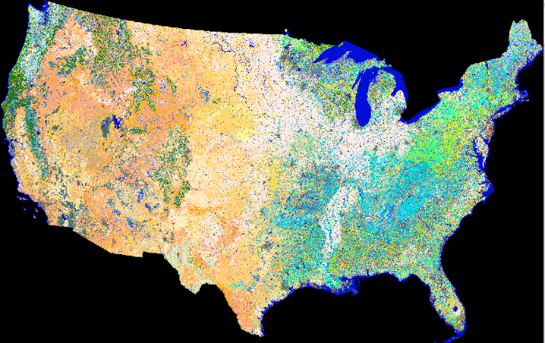
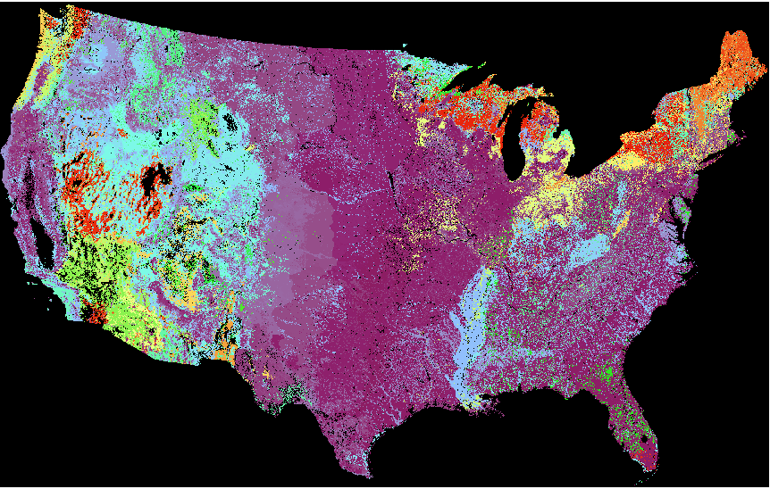
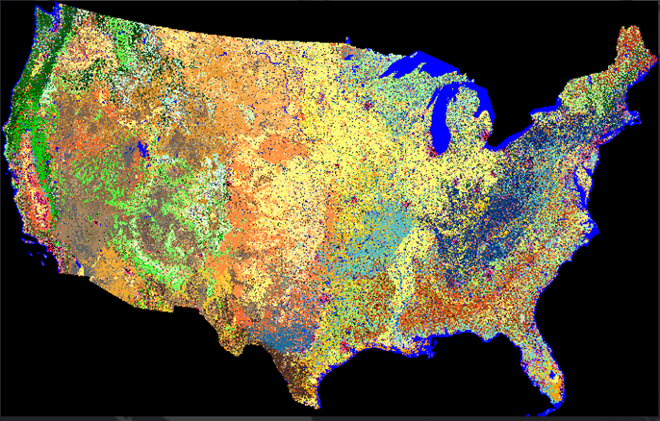
LANDFIRE Layers
All lands in United States and insular areas at the 30m pixel level
Landsat Image Composites and Indices
Topographic
Disturbance
Vegetation
Existing Vegetation Type (ES)
Existing Vegetation Cover
Existing Vegetation Height
Fuels
Fire Regime
Reference
Notes:
Over 30 spatial data layers. Comprehensive, Consistent, Congruous, and Comparable – See the fact sheet for general LF data info.
Note all the arrows going to vegetation and the major dependencies on vegetation– these are key layers for LANDFIRE and our improvements in vegetation will lead to improved fuels mapping as well.

Slide 4
Vegetation mapping in LANDFIRE
Base maps: Machine learning models with clean imagery and plot training data to model dominant lifeform first, then existing vegetation cover, height, and type
Updates: Rulesets with vegetation type, cover, height, disturbance type, severity and time since disturbance inputs
  Rulesets developed with Forest Vegetation Simulator for trees and heuristically for herb and shrub
  Disturbance and regrowth combined
Notes:
Done with LF2020 for CONUS, AK, HI and USVI/PR exception are a few fire regime layers. Goal is to make our updates work more like the base map methodology and account for the disturbances experienced the year before in the next release. LF2022 will be released in 2023.

Slide 5
Image-based prototype for vegetation mapping
Create updates that follow the basic methodology of base maps using current imagery and training data
Modeling goals
  Capture change every year with recent imagery, less lag, more usability
  Focus on lifeform, cover (EVC) and height (EVH)
  Focus on disturbed areas/greatest change
  Use standard validation techniques to show how changes impact outputs
  Feed results into fuels mapping
Notes:
Advancements in image compositing that has reduced time and eliminated hand editing.

Slide 6
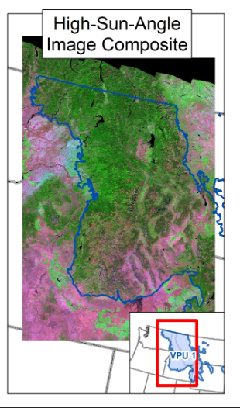
Prototype study area
Vegetation Production Unit (VPU) 1:
Northwestern portion of the United States (Washington, Idaho, Montana, Wyoming)
Notes:
Chosen because it has a lot of disturbances/fires and slower recovery times. Variation in dominant lifeforms. North to get 90km buffer area.

Slide 7
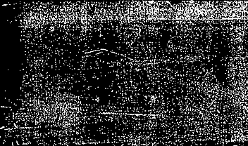

Modeling lifeform after disturbance
Challenges:
  No training data – plots are typically located in non-disturbed areas and mostly treed
  Date range of Landsat scenes used for Spring/Fall disturbance image composites contained data gaps resulting from clouds and cloud shadows
  Modeling incorrectly due to terrain shadows and standing dead
Notes:
Whether something is a small tree or herbaceous makes a big difference to how it will burn so lifeform is critical in LF.

Slide 8
Modeling Lifeform: Methodology
Create
Create lifeform mask from convergence of evidence and gathered random samples for training and validation- disturbed areas only
Extract
Extract numerous independent variables including imagery and indices
Optimize
Optimize amongst classification models: See5, XGBoost, Random Forest, XGBRF, Light Gradient Boosting Machine
Notes:
We did try modeling with our LFRDB in non-disturbed plots originally, but the results weren’t great, so we restricted our training data to disturbed areas.

Slide 9
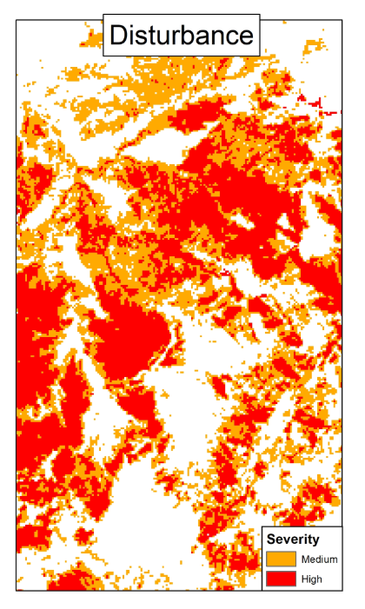
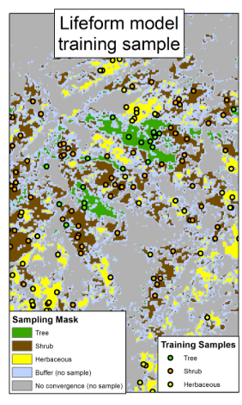
Modeling Lifeform: Training
​
​​
Original sampling 65,734​
59,161 training plots​
6,573 test plots (10%)
Random samples were proportionally stratified by lifeform
Notes:
Lifeform training sampling stratification​ (left) Disturbed areas only
NLCD 2019, LCMS 2020, LCMAP 2020 (tree only), RAP​ 2020
Herb and shrub – 2 agreed​
Tree – 3 agreed​
Med or High severity for 2011-2018
All of our traditional training plots are non-disturbed. This does not help us in disturbed areas.

Slide 10
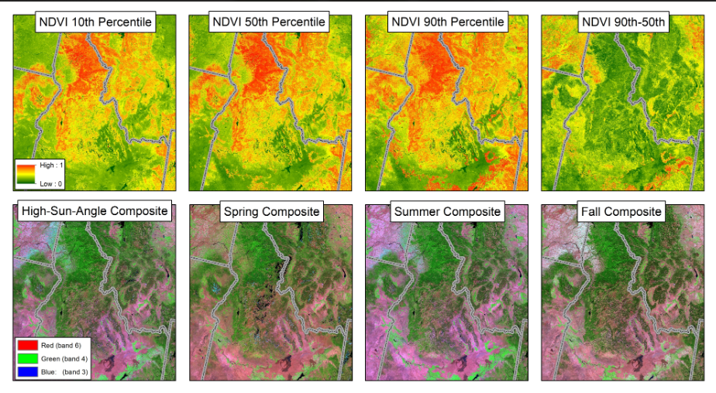
Modeling Lifeform: Imagery
Notes:
We tried a wide array of possible Landsat imagery and indices inputs. Model consistently ranked the 10th percentile for NDVI (March 1 through October 15) as an important variable we think because there is a bigger difference in the lower percentiles between herb/shrub vs tree lifeforms.
Tried high sun angle to minimize terrain shadowing May 1-Aug15, but Summer composite appears to get better results (June 16-Aug31)

Slide 11
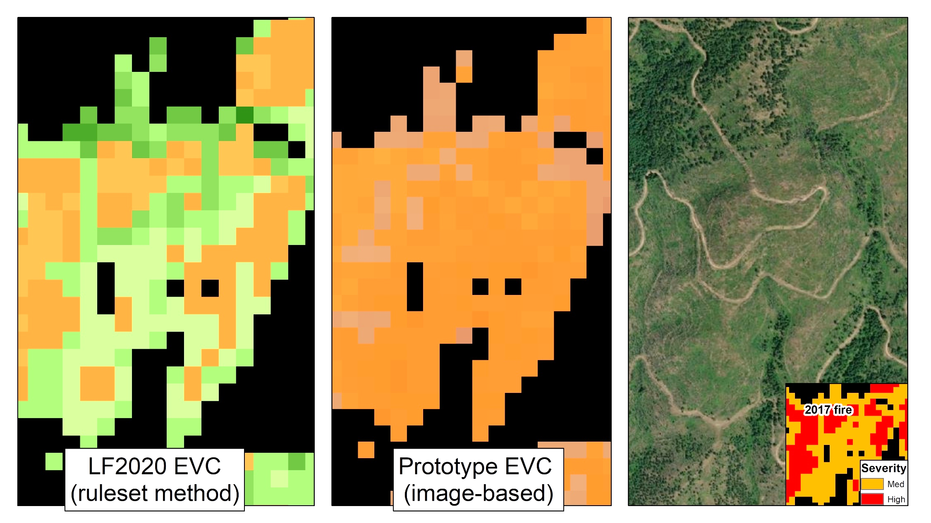
Modeling Lifeform: Examples
Lifeform
Lifeform
Date 7/7/2021 Maxar ESRI base imagery
Notes:
The moderate severity actually reduced the trees- hard to detect with dNBR

Slide 12
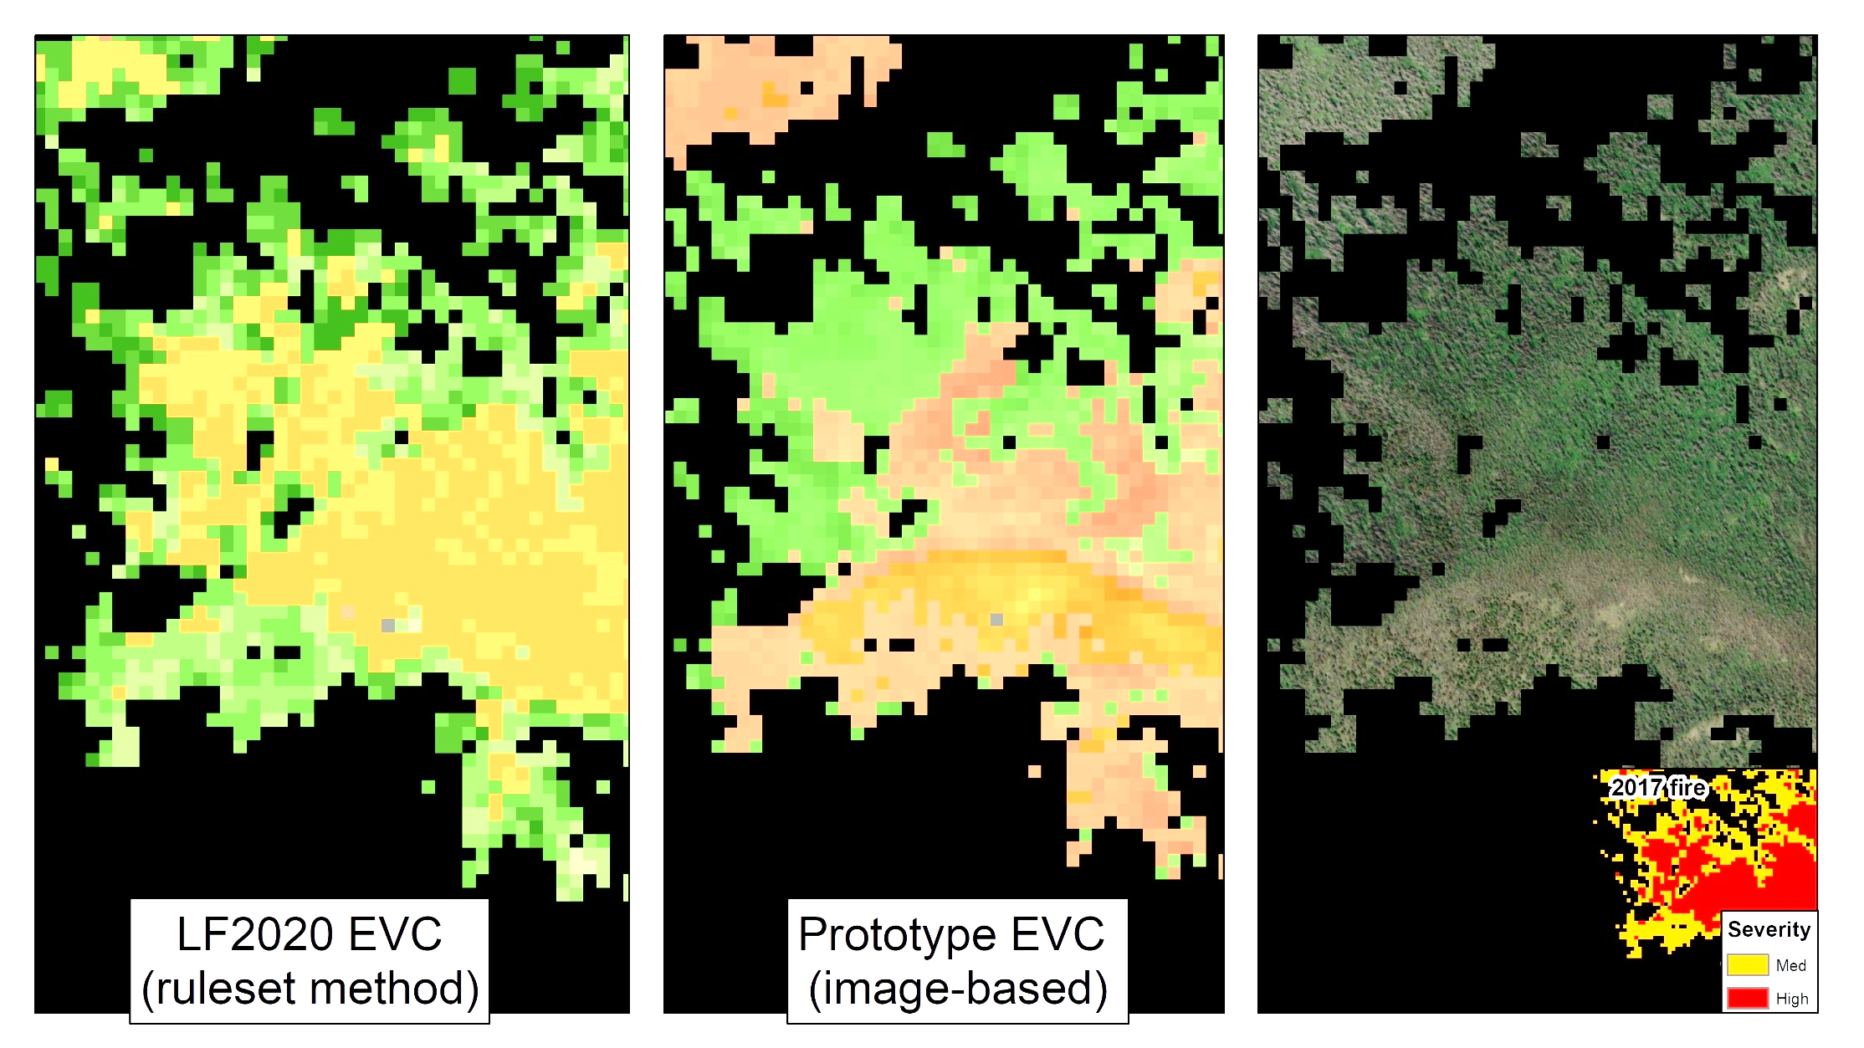
Modeling Lifeform: Example
Lifeform
Lifeform
Date 7/21 Maxar ESRI base imagery
Notes:
The gradations from herb to shrub to trees might be easier to capture with the image based – where initial severity isn’t as important and where site specific conditions dominate….aren’t as abrupt as the ruleset approach.

Slide 13
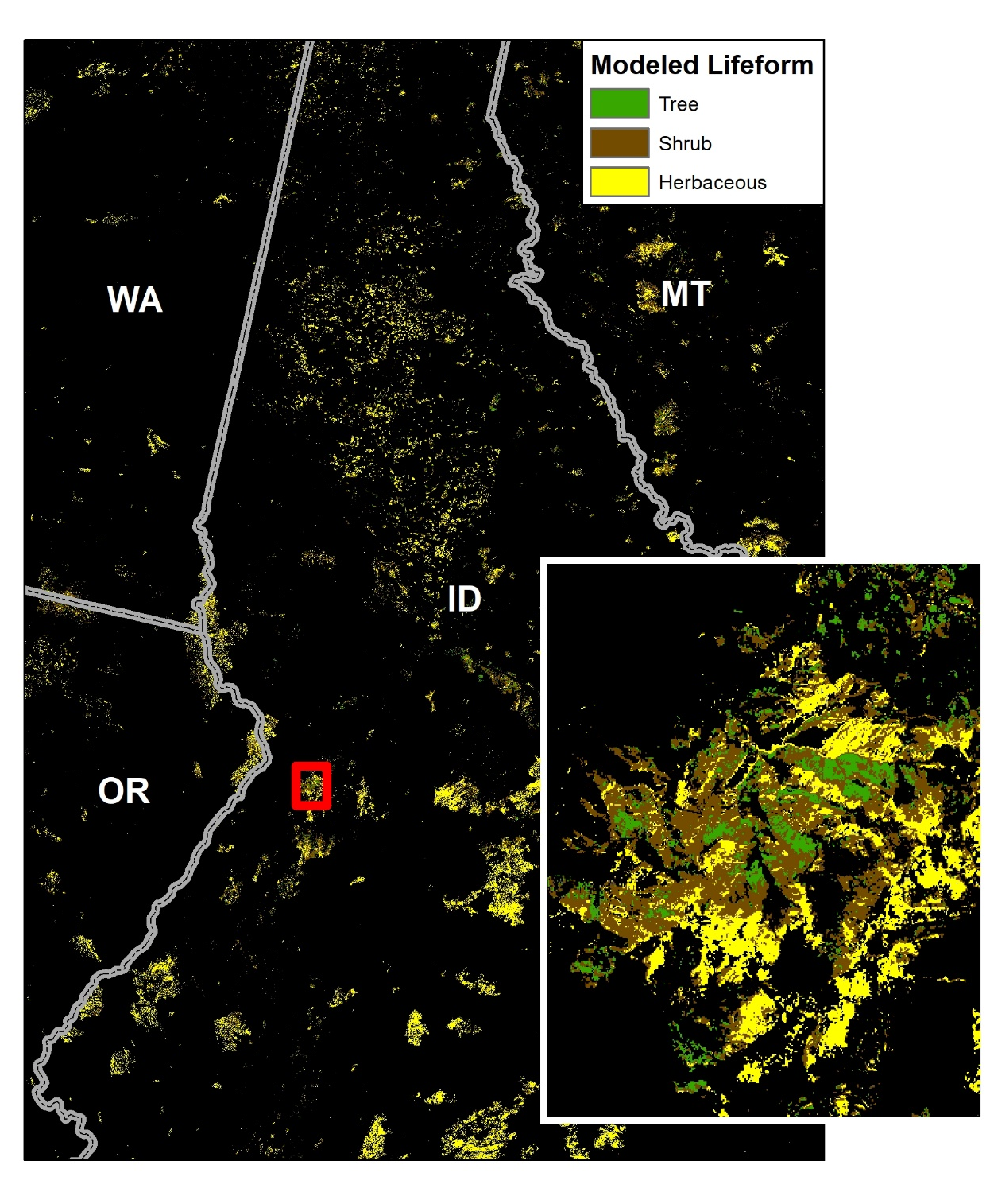
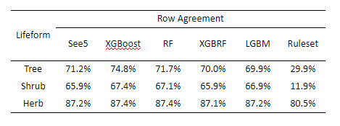
Lifeform metrics
10% of training samples from lifeform mask were kept for testing
​
Notes:
Many models tested – focus was on commission error agreement XGBoost performed best. LGBM- light gradient boosted machine.
Huge gain in agreement for small region for lifeform. How will this apply to other areas?

Slide 14
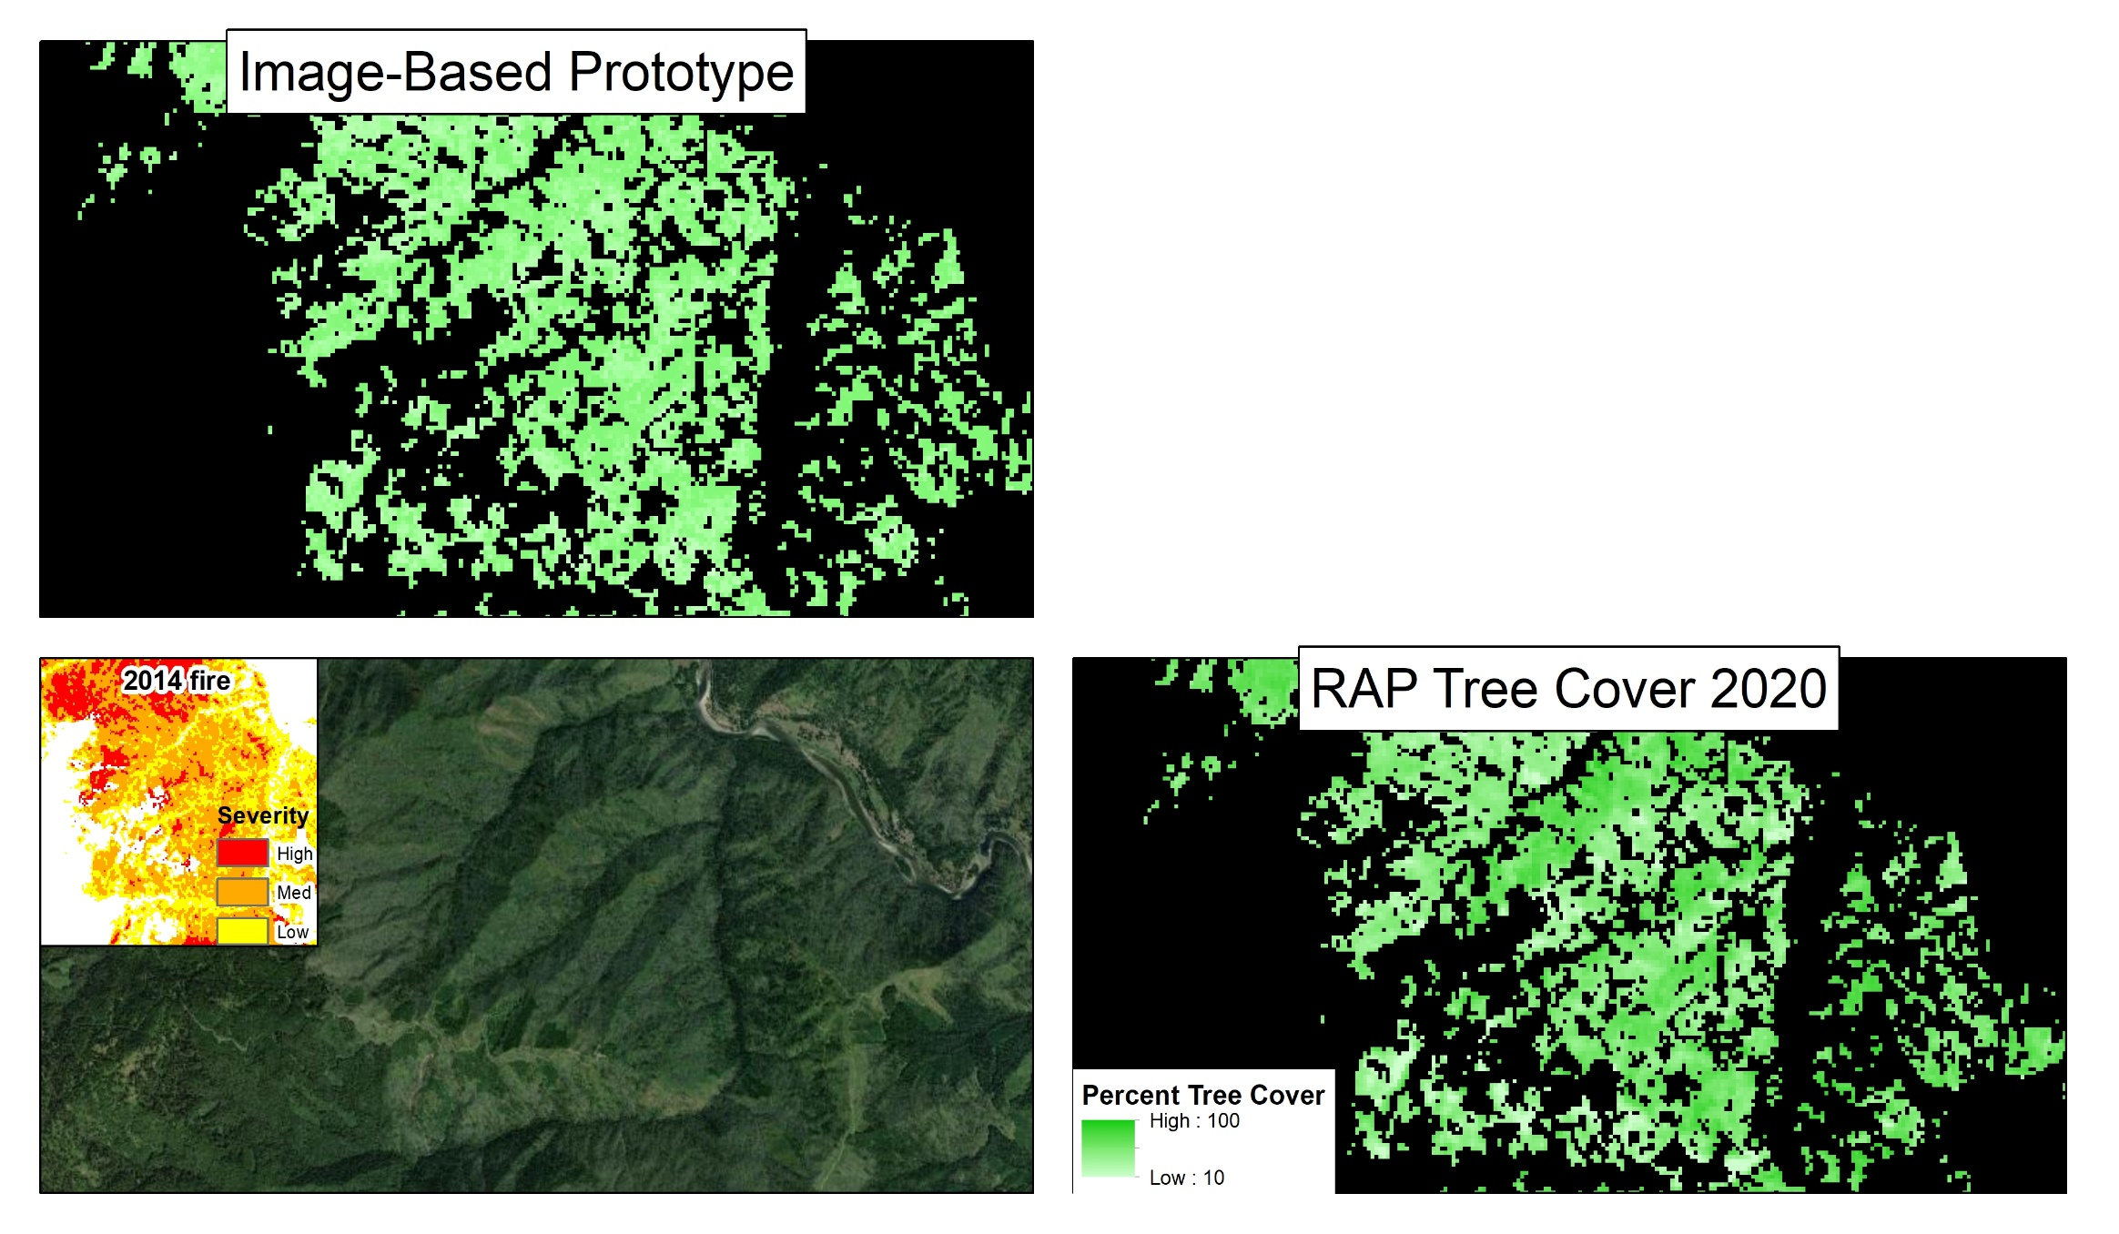
Modeling Existing Vegetation Cover
Cover trained with non-disturbed plots from LANDFIRE reference database
Rangeland Analysis Platform (RAP) cover predictions are different than image-based prototype in disturbed areas
Post-disturbance lidar or plot data needed for assessment
Date 8/29/2020 Maxar ESRI base imagery
Notes:
Compared to Rangeland analysis platform tree cover for 2020 disturbed areas since we have no disturbed plot data yet. RAP= Temporal convolutional neural network with landsat imagery and indices. RAP cover paper: doi/10.1111/2041-210X.13564 – we don’t know what the accuracy is for disturbed areas

Slide 15
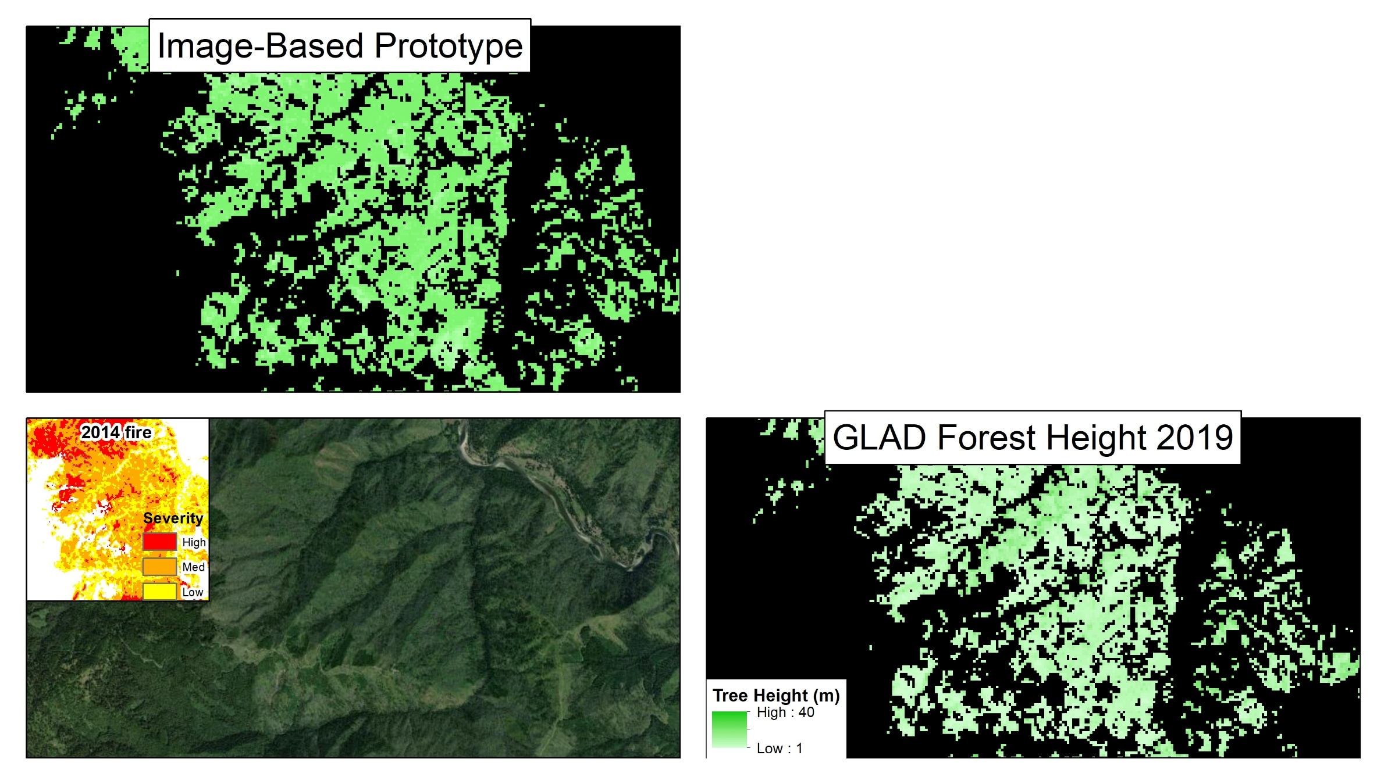

Modeling Existing Vegetation Height
Height trained with non-disturbed plots from LANDFIRE reference database and sampled aerial lidar
Global land analysis and discovery lab (GLAD) global forest canopy height predictions are different than image-based prototype in disturbed areas
Post-disturbance lidar or plot data needed for assessment
Date 8/29/2020 Maxar ESRI base imagery
Notes:
Compared our disturbed heights to 2019 GLAD global forest canopy height since we have no disturbed plot data to pull from yet. 2019 GEDI/Landsat integration group from UMD P. Potapov, X. Li, A. Hernandez-Serna, A. Tyukavina, M.C. Hansen, A. Kommareddy, A. Pickens, S. Turubanova, H. Tang, C. E. Silva, J. Armston, R. Dubayah, J. B. Blair, M. Hofton (2020). Global Forest Canopy Height, 2019 | GLAD (umd.edu)

Slide 16
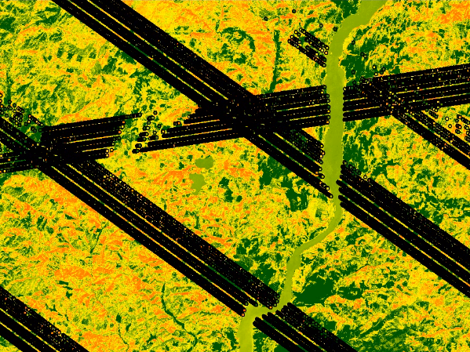
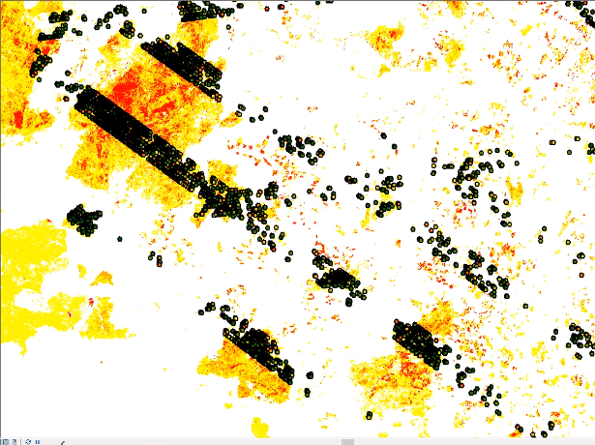
Next Steps/ Challenges
Incorporating new lidar to inform lifeform, cover and height modeling
  Discrete airborne: 3DEP, GLiHT, NEON
  Waveform space-born: GEDI 2B for cover, 2A for height
How to incorporate/manage higher resolution imagery
Low severity disturbances
Transfer improvements to non-disturbed areas/succession
Flow to fuels canopy cover and canopy height needs to be coordinated with surface fuel model rules
Continue to improve production processes using data driven approaches

Slide 17
Conclusions
Need to model disturbed lifeform disturbed areas separate from non-disturbed
XGBoost best model for prototype area lifeform modeling
In absence of plot data, we can use convergence of evidence from other data sources to help train our lifeform model, but they need to be current
Comprehensive and repeated post-disturbance plot and lidar data is highly valuable
Technology has given us the ability to move away from rulesets which had to ‘lump’ transitions due complexity
Notes:
If you have post-disturbance plot data please let us know.

Slide 18
Acknowledgements
ENTIRE LANDFIRE IMPROVEMENTS AND INNOVATIONS TEAM
USDA FS, DOI, USGS, TNC, KBR, ASRC
BUSINESS: HENRY BASTIAN, JIM MENAKIS, TIM HATTEN, JIM SMITH, MARCI HYSER
CONTACT ME- INGA LA PUMA: ilapuma@contractor.usgs.gov
LANDFIRE HELPDESK: helpdesk@landfire.gov
DOWNLOAD DATA: LANDFIRE Program: Get Data

