Slide 1
Painting the landscape by number: The use of image segmentation or buffering to improve geospatial vegetation classification 10/25/2022
Joshua J. Picotte*^{,1}, Daryn Dockter², and Timothy D. Hatten³
*jpicotte@contractor.usgs.gov
¹ASRC Federal Data Solutions, contractor to the United States Geological Survey (USGS) Earth Resources Observation and Science (EROS) Center, Sioux Falls, SD 57198, USA. Contract 140G0119C0001
²KBR contractor to the USGS EROS Center, Sioux Falls, SD 57198, USA. Contract 140G0121D0001
³USGS EROS Center, Sioux Falls, SD 57198, USA.

Slide 2
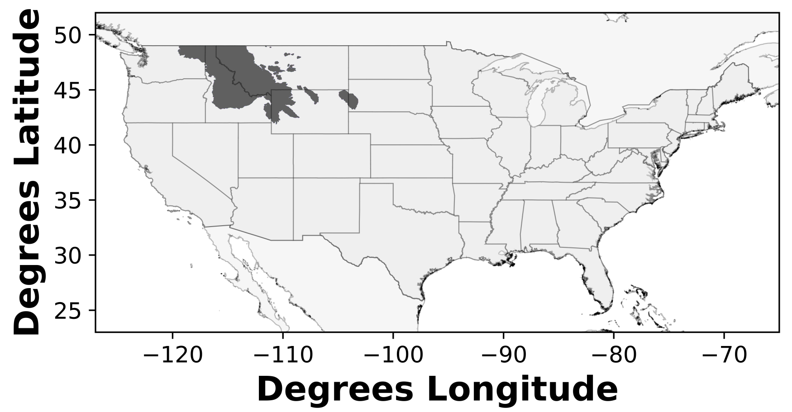
Overview
Why?
Background
Plot Segmentation and Buffering
Results
Conclusions
Vegetation Production Unit (VPU) 01

Slide 3
Why?
Increase sample size
Determine best sampling strategy
Improve models and reduce production latency
Initial modeling, mapping, and error analyses processes are currently being used within LANDFIRE lifeform modeling processes to improve efficiencies

Slide 4
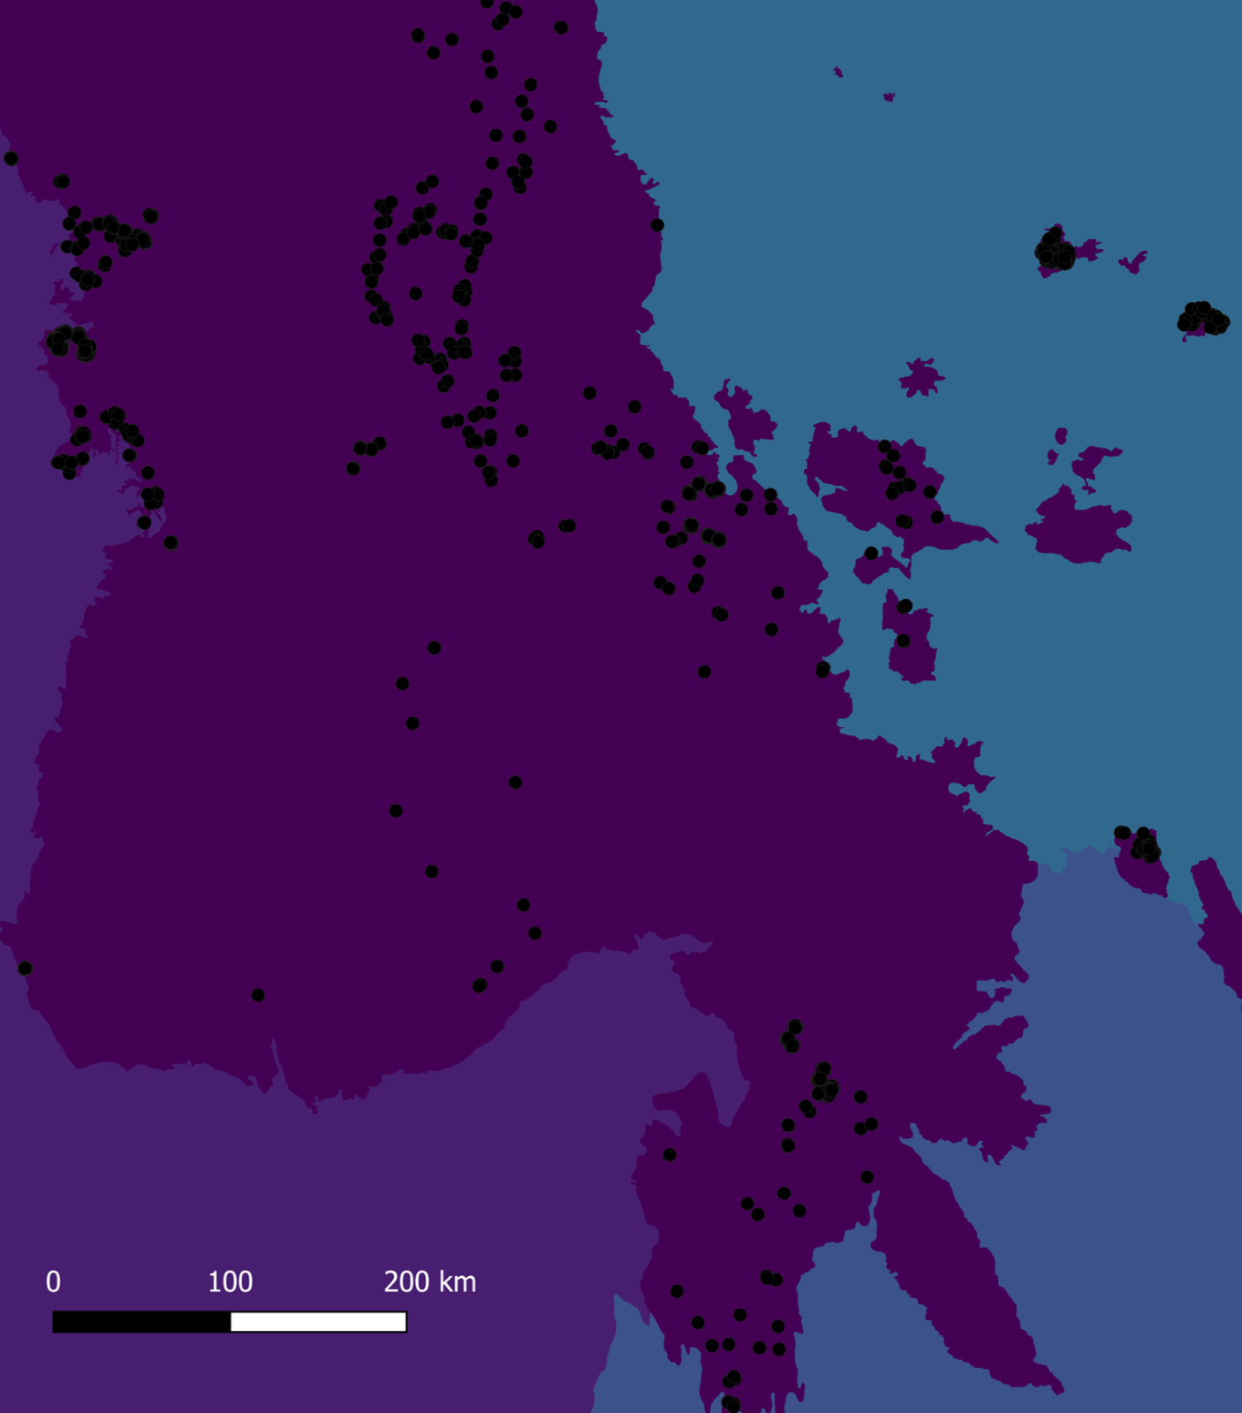
Background – LANDFIRE Reference Database (LFRDB) Plots
Vegetation and Fuel Data
Federal, State, and other user submitted data
Differences in collection methodologies
Variable plot diameters and distribution

Slide 5
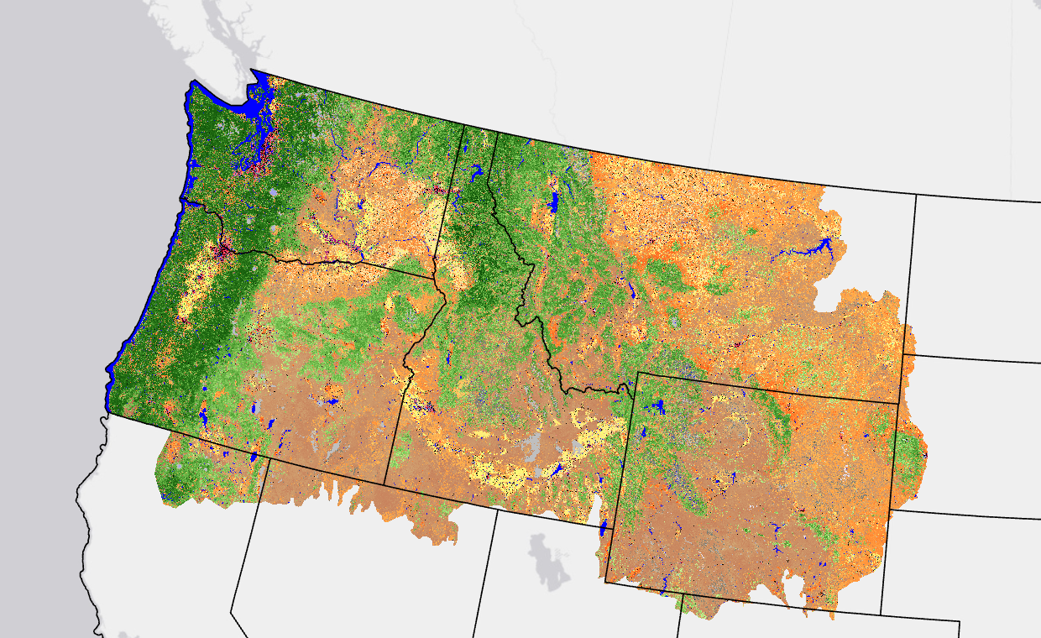
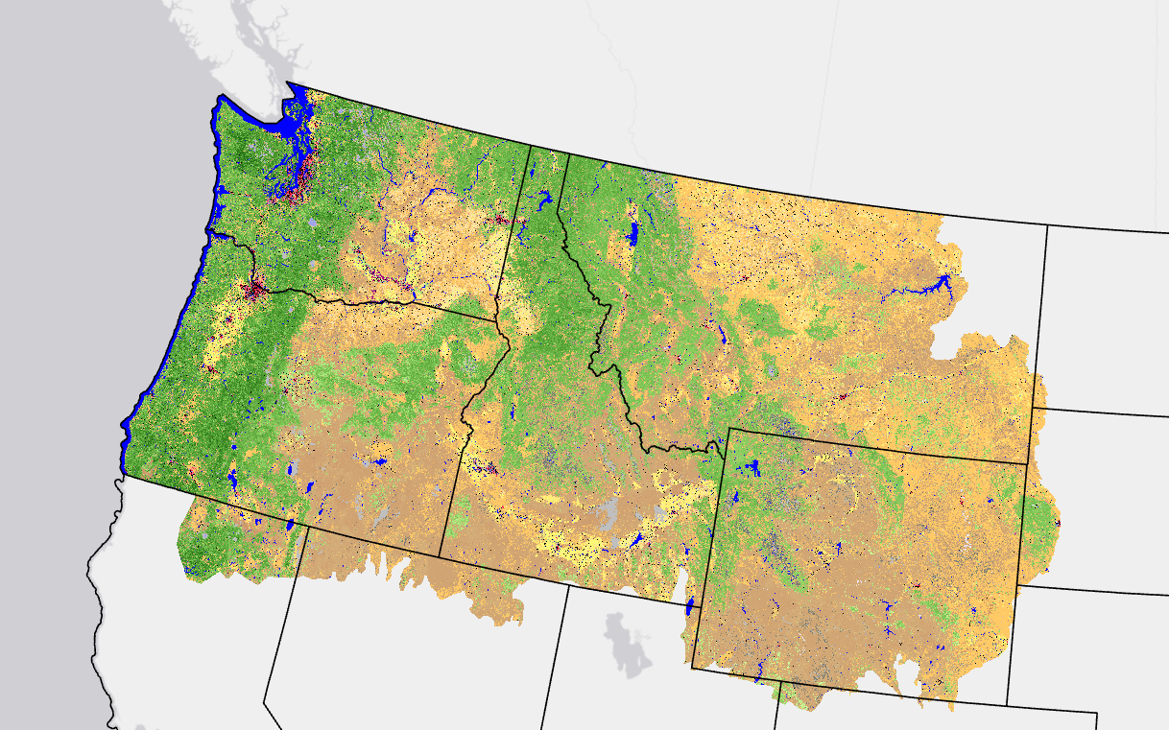
Existing Vegetation Cover (EVC) and Height (EVH)
EVC
EVH
https://landfire.cr.usgs.gov/geoareasmaps/LF2016/LF2016Remap_EVC_forweb_NW.png
https://landfire.cr.usgs.gov/geoareasmaps/LF2016/LF2016Remap_EVH_forweb_NW.png
Percent Cover
10- 100% cover
Height
In meters
30 m product (Landsat)
Tree, herb, and shrub layers

Slide 6
Previous Modeling and Mapping Processes
LFRDB
Query
LFRDB
and lidar
data
Input Raster Data
Model
EVC/EVH
raster

Slide 7
Modeling and Mapping Process
LFRDB
Query
Previous modeling processes extended:
Increases modeling efficiencies
Allows LANDFIRE to determine the fit of each model and map
New capabilities:
Buffering
Segmentation
Segmentation mean filter
LFRDB
and lidar
data
Data filter,
split
test/train, and
balance
Test
and
Train
Buffer plots
Input Raster Data
data
Model
Segmentation
algorithm
EVC/EVH
raster
Segment
raster
Mean
filter
Filtered
Error
Map
R²
EVC/EVH
assessment
raster

Slide 8
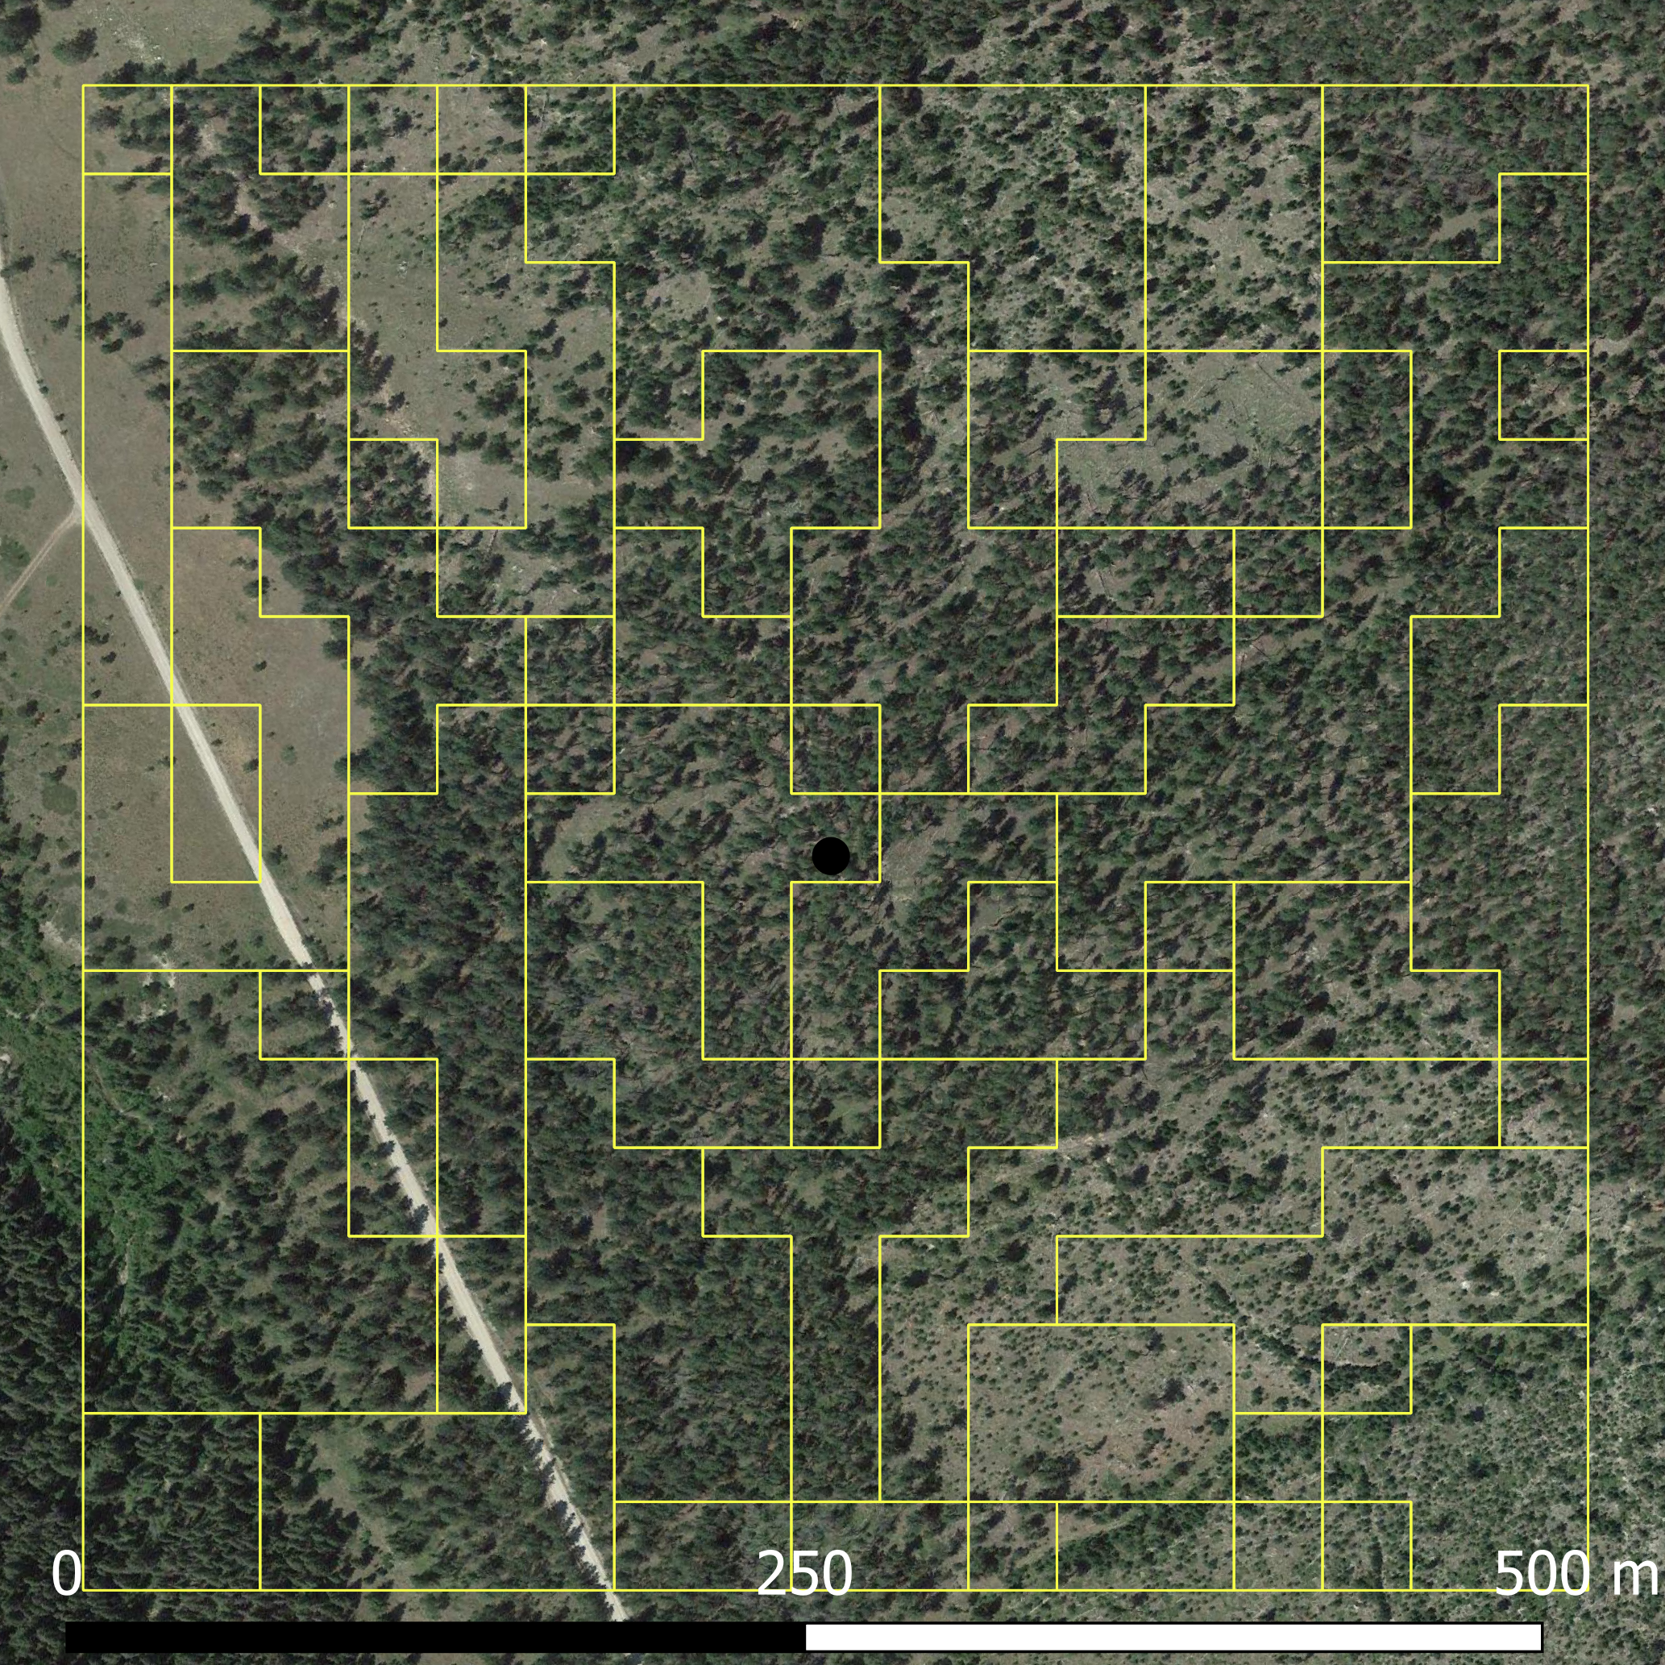
Background - Plot Segmentation
Felzenszwalb and Huttenlocher (2004) algorithm
Uses 3+ rasters
NDVI minimum, maximum, and mean
Examines pixel similarity
Minimum N = 1
Maximum N = 500
Felzenszwalb, P.F. and Huttenlocher, D.P., 2004. Efficient graph-based image segmentation. International journal of computer vision, 59(2), pp.167-181.

Slide 9
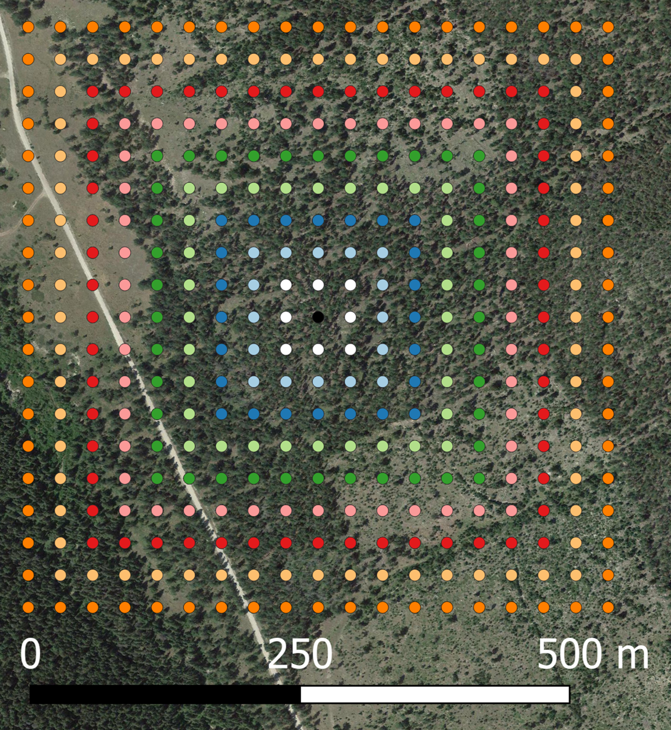
Background - Plot Buffering
Simple extraction with every touching pixel
Ranged from within 1-10 pixels
Minimum N = 9
Maximum N = 361

Slide 10
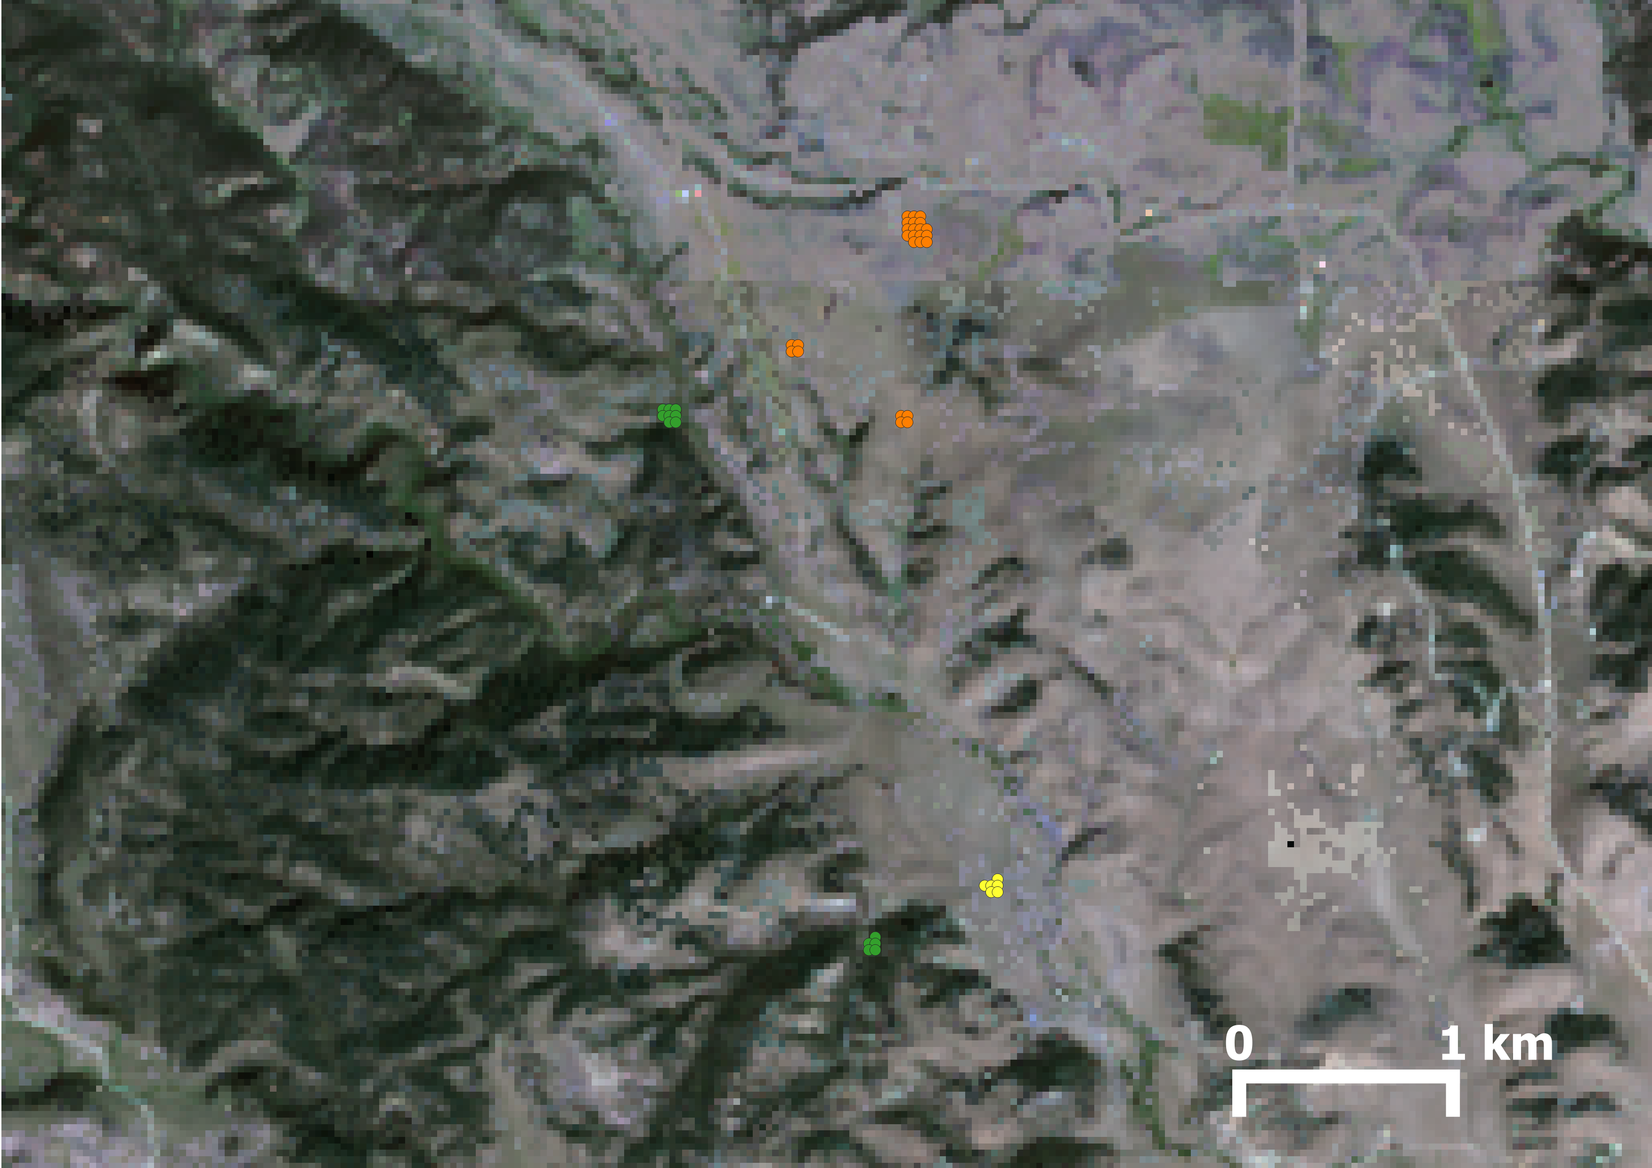
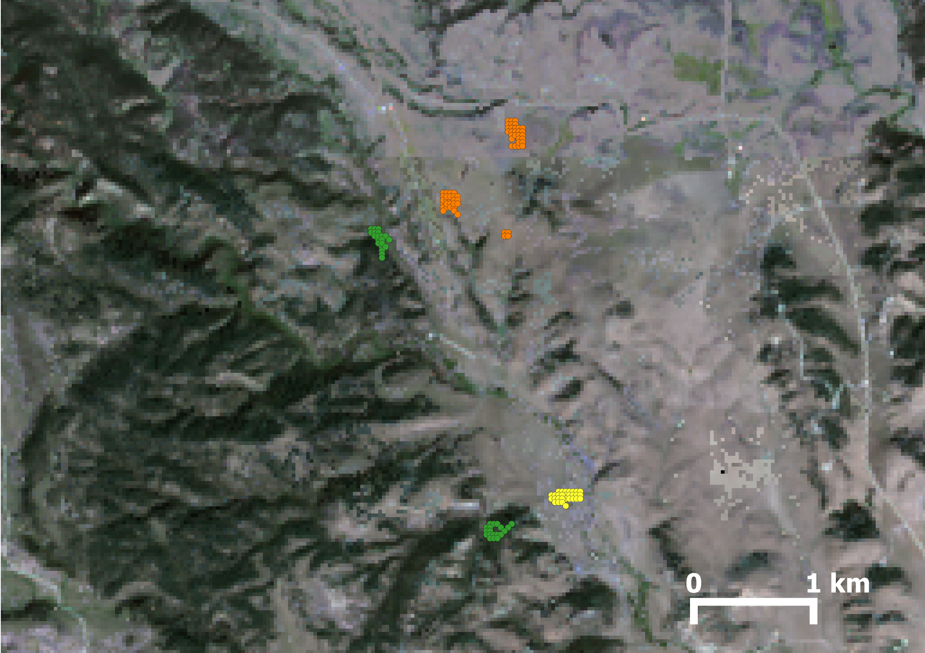
Background-Extraction EVC/EVH
Original
Segment Extracted
N = 44
N = 237
Tree
Shrub
Herb

Slide 11

Background - Machine Learning and Post-Processing
Machine Learning
Random Forest (RF)
XGBoost
XGBoost Random
Forest (XGBRF)
Light Gradient Boost Machine (LGBM)
Cubist
Post-Processing
Segments as a majority filter

Slide 12
Results - EVC
Buffered Modeled
Tree
Segment Filtered R²
Tree – 0.71
Herb – 0.48
Shrub – 0.15
Segment Modeled R²
Tree – 0.70
Herb – 0.49
Shrub – 0.23
Shrub
Herb

Slide 13
Results - EVH
Buffered Modeled
Tree
Segment Filtered R²
Tree – 0.59
Herb – 0.39
Shrub – 0.29
Segment Modeled R²
Tree – 0.58
Herb – 0.35
Shrub – 0.33
Shrub
Herb

Slide 14
Conclusions – EVC and EVH
Similar trends
Tree – Buffer best, ideal buffering distance 1 pixel
Herb – Buffer best, ideal buffering distance 4-5 pixel
Shrub – Segment modeled best
Mean segment filter did not improve maps
Lidar data improved the tree masks and likely reduced the need for increased buffering distance
Ideal buffer typically one pixel (N = 9), except for herbs where there may be larger variations in independent data values, plot measurements, or plot sizes
Both segmentation and buffering can improve models, because expanding beyond one-pixel better accounts for plot spatial extents and reduces overall error
By identifying the best possible data distribution, modeling, and mapping procedures we can improve modeling efficiencies and potentially speed up product delivery within and across annual delivery cycles

Slide 15
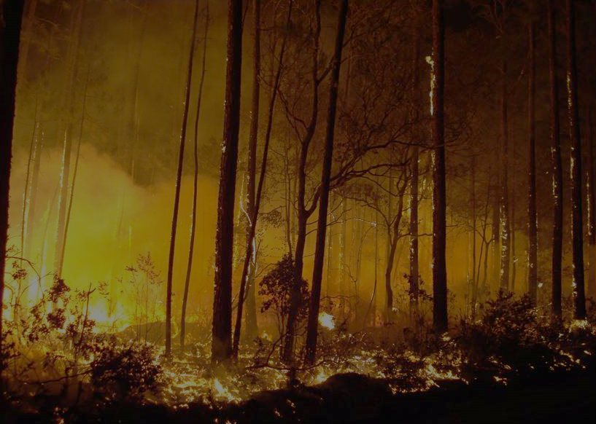
Comments/Questions?
jpicotte@contractor.usgs.gov

