Slide 1
LANDFIRE image-based update prototype
Detailed annual updates to vegetation maps for the U.S. using machine learning
Daryn Dockter, Inga La Puma, Brian Tolk (KBR) and Josh Picotte (AFDS)
Contractors to the U.S. Geological Survey (USGS) Earth Resources Observation and Science (EROS)
Work performed under USGS contract 140G0121D0001 and 140G0119C0001
Notes:
Along with a team of others, support vegetation mapping for LANDFIRE
LANDFIRE produces nearly 30 geospatial products for the United States
Related to Disturbances, Vegetation, Fuels, and Fire Regimes
Applications for wildland fire and land resource management among many others

Slide 2
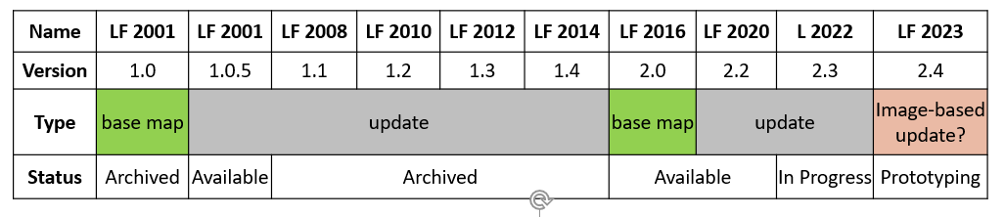

Image-Based Update
Prototype Goals
More: model post-disturbance vegetation with recent imagery and machine learning
Better: replace rulesets and improve modeling performance
Faster: enable annual updates by reducing modeling time through automation
Notes:
Recent initiative for ‘image-based update’
LANDFIRE’s original base map was circa 2001 that mapped all 30m pixels using Landsat imagery and ML
‘Updated’ using transition rulesets to account for disturbances – no imagery or ML involved
Second ‘base map’ for LF 2016 to ‘remap’ all pixels using imagery and ML
Want to build on Remap and incorporate ML modeling into updates
At a minimum - model post-disturbance vegetation rather than use rulesets
Goal to speed up modeling process to enable annual updates using ML
Potential for remapping all pixels more frequently

Slide 3
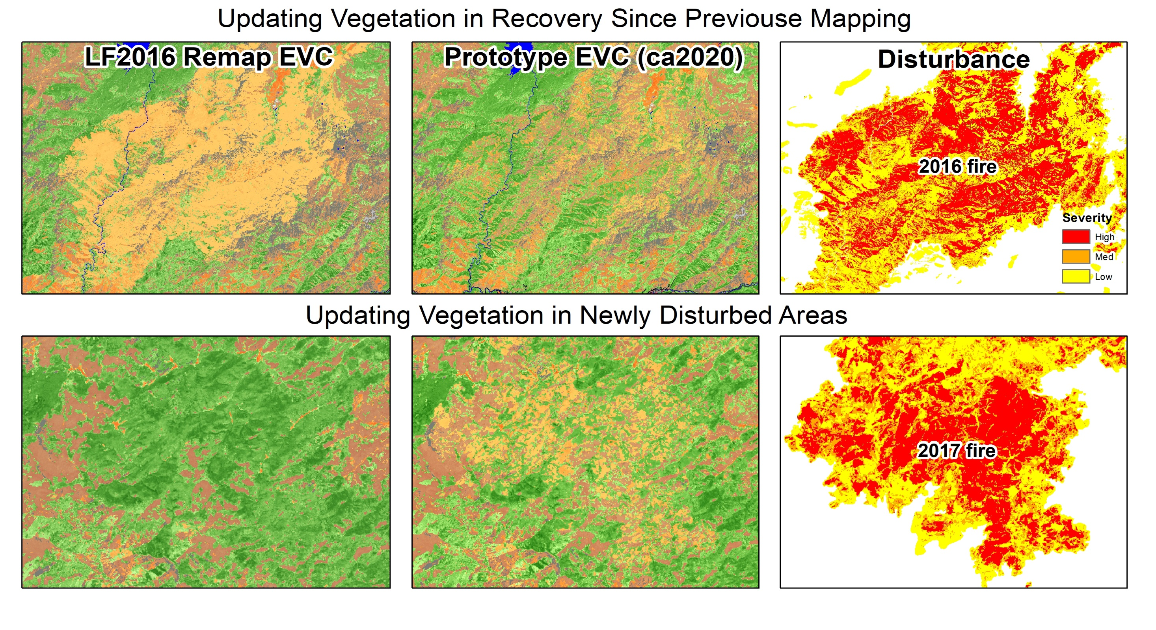
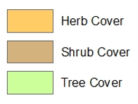
Updating Vegetation in Recovery Since Previous Mapping
Notes:
Shows the idea of what we’re talking about
- used moderate and high severity disturbances as ‘mask’ to bring through ML modeled results into base map
- increases and decreases in vegetation
- started using 2020 Landsat percentile composites used for disturbance mapping in VPU 6 (SC US) then VPU 1 (Interior NW)
- train model using plots outside disturbance – no post-disturbance plots yet
- looked okay but upon further inspection of recent aerials noticed commission of trees, especially on north-facing slopes
- reflectance of post-disturbance vegetation not represented in training data

Slide 4
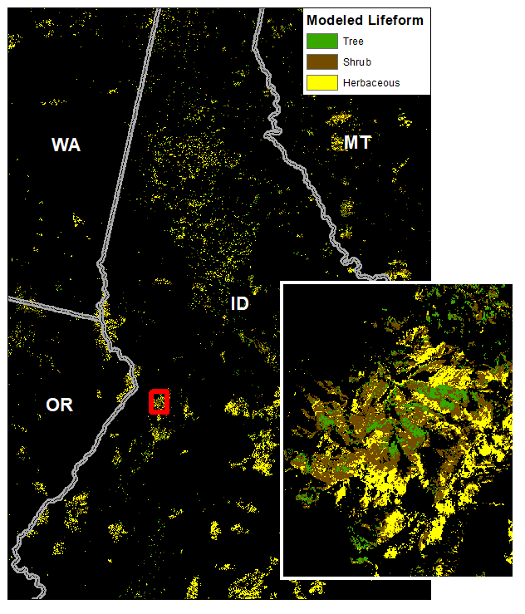
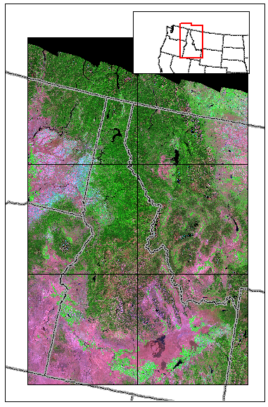
Prototype Area
Notes:
Created high-sun-angle image composite (more centered on summer solstice) for two tiles, expanded to then six tiles for larger training set
Also added NDVI composite
Giving similar results, commission of trees
Focus on Lifeform – important base layer for veg and fuels
Background: Lifeform is thematic map of tree/shrub/herb using supervised classification
Predictors = Landsat
Training samples = field plots from LF Reference DB (LFRDB)
Investigated ways to improve model

Slide 5
Lifeform Modeling in Disturbed Areas
High Sun-Angle composite
Add Expert Opinion (Desktop) Plots in difficult areas
Add independent ‘predictor’ variables
  Disturbance Severity (Low, Med, High) and Year
  Solar Radiation
  Different windows for NDVI image composite
  Seasonal image composites
Balance training plots based on expected proportion of tree/shrub/herb
Filtered plots by consensus map
Add training samples from consensus map in disturbed areas
Notes:
What we tried to improve models
Filtering on Consensus Map (Remap, NLCD, LCMS, RAP) - Keep field plot if label agrees with at least two maps agree with LFRDB
Iterations on NDVI composite (models grabbing on to band 4 diff which is probably trees) - Too short, too long, just right
Seasonal composites - added to see if they help pick out phenology differences for lifeform
Sampling on consensus map within disturbances (NLCD, LCMAP, LCMS, RAP) - Seemed to work best

Slide 6
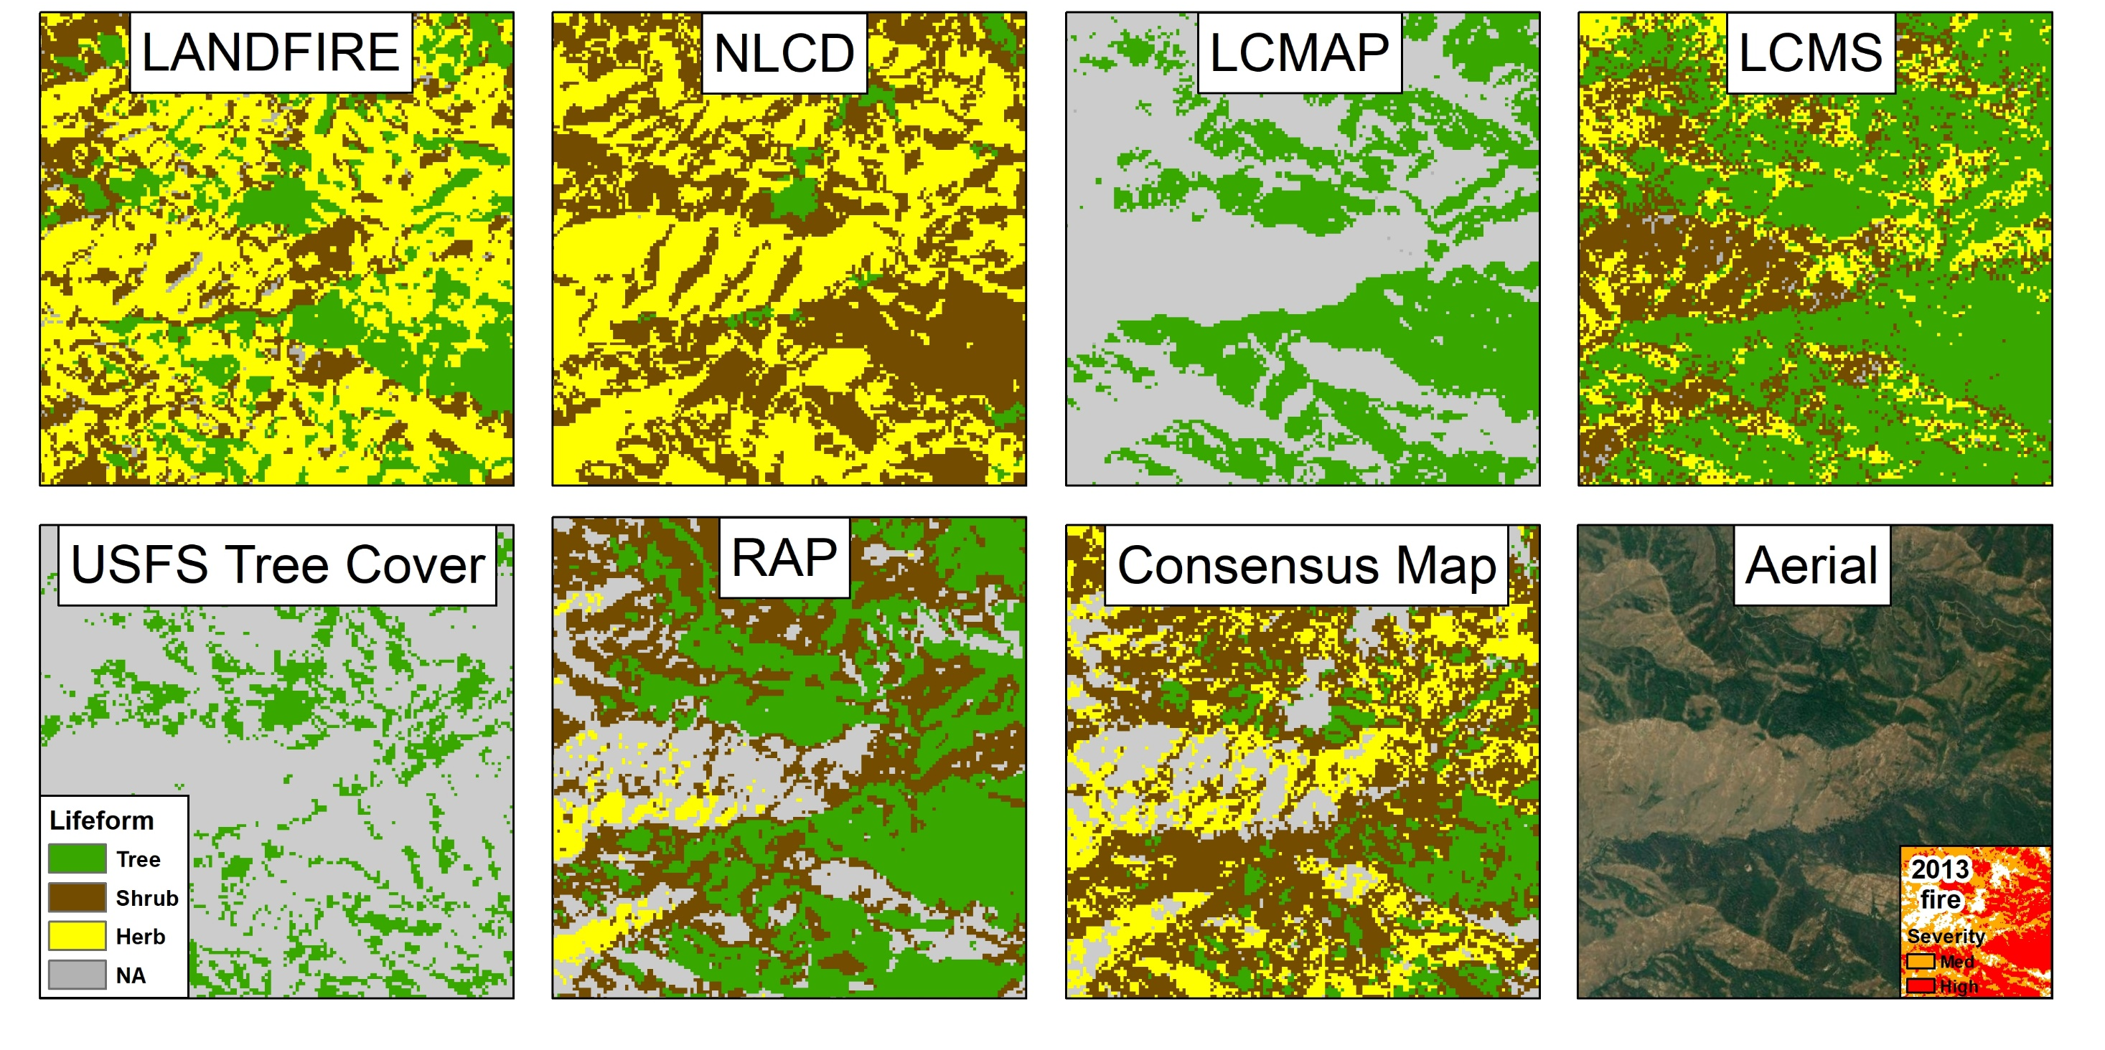
Example of Consensus Map
Notes:
Example of Consensus Map
LANDFIRE Remap, NLCD 2019, LCMAP 2020, LCMS 2020, USFS Tree Cover 2016, RAP 2020
Also used RCMAP and looking at using GLAD too
At least 2 agree for Shrub and Herb
At least 3 agree for Tree
Tree trumps Shrub trumps Herb
Tree
- NLCD 41, 42, 43, 90 AND LCMAP 4 AND LCMS 1, 2, 3, 4, 5
- NLCD 41, 42, 43, 90 AND LCMAP 4 AND RAP >= 40%
- NLCD 41, 42, 43, 90 AND LCMS 1, 2, 3, 4, 5 AND RAP >= 40%
- LCMS 1, 2, 3, 4, 5 AND LCMAP 4 AND RAP >= 40%
Shrub
- NLCD 52, 90 AND LCMS 1, 2, 3, 4, 6, 7, 8, 9
- NLCD 52, 90 AND RAP >=20% shrub
- LCMS 1, 2, 3, 4, 6, 7, 8, 9 AND RAP >=20% shrub
Herb
- NLCD 71,95 AND LCMS 4, 8, 10, 11
- NLCD 71, 95 AND RAP > 30% herb (annual + perennial)
- LCMS 4, 8, 10, 11 AND RAP > 30% herb
Buffer by 1 pixel to avoid sampling on margins or mixed pixels

Slide 7
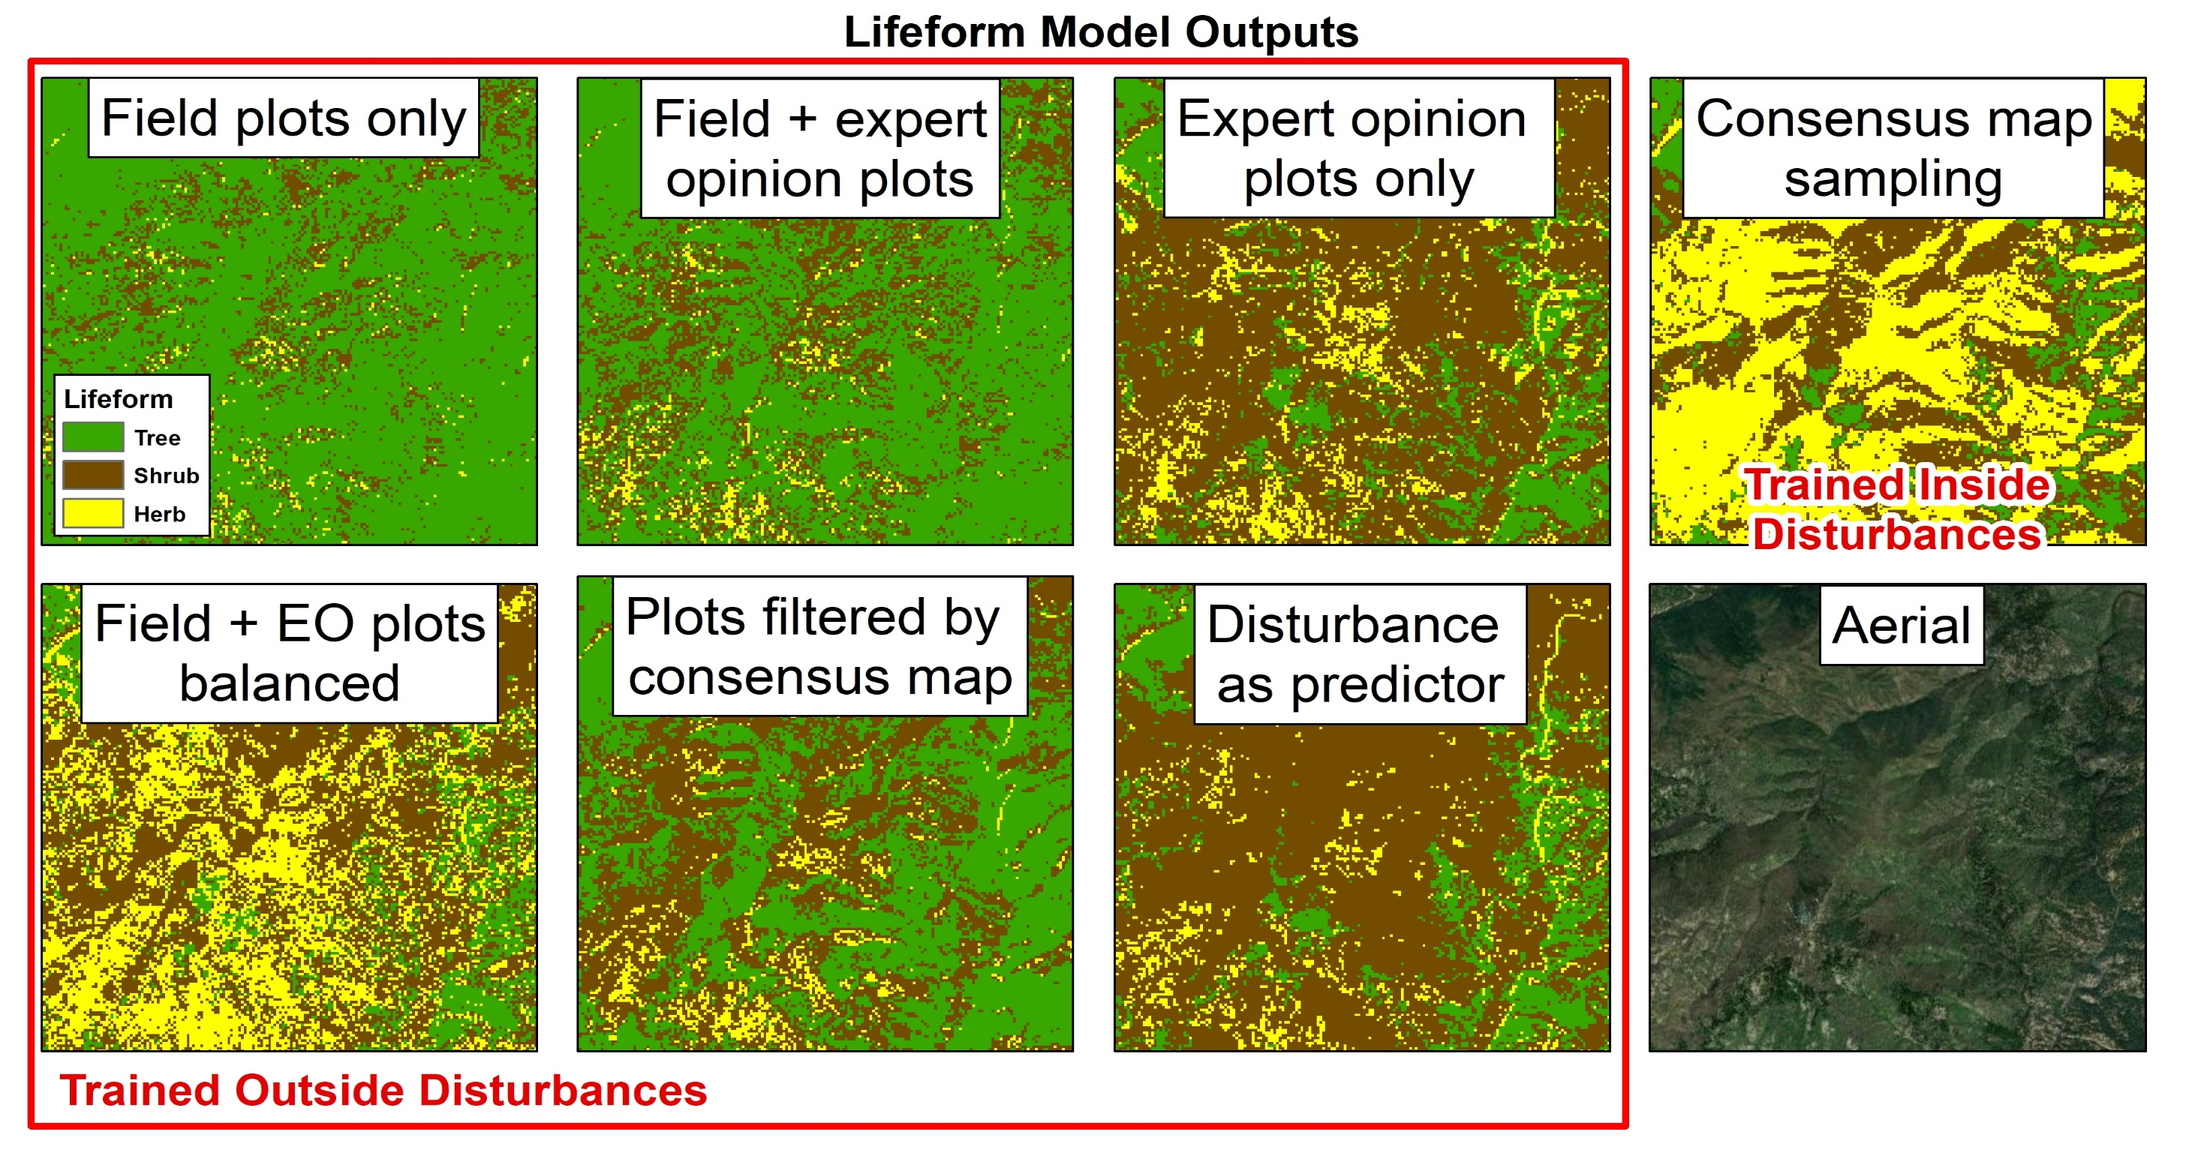
Lifeform Model Outputs
Notes:
Results of different iterations
Field plots only – overmaps trees
Adding expert opinion plots introduces more herb and shrub but still overmapping trees
Filtering by consensus helps but still overmaps trees
Expert opinion only is good but requires a lot of time/effort
Balancing helps but does still mismapping
Disturbance as predictor overmapped shrub/herb
Best results were to use consensus map samples

Slide 8
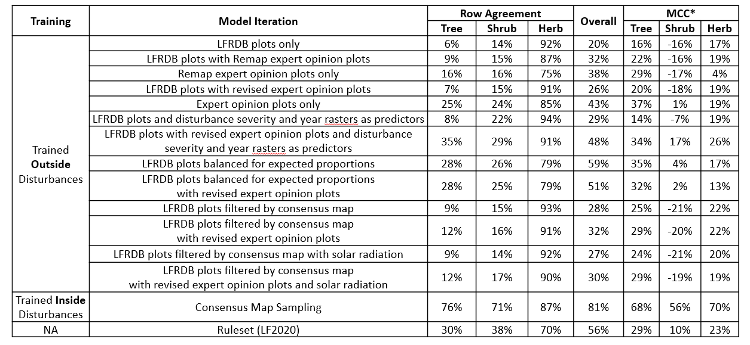
Lifeform Modeling in Disturbed Areas
Assessed by consensus map samples in disturbed areas
* MCC = Matthew’s Correlation Coefficient
Note: all models generated with See5 using same image composites (high-sun-angle, tasseled cap, and NDVI)
Notes:
Results of agreement assessment
Tried several improvements, then sampled inside disturbances and used those holdout plots to assess previous iterations (about 6,500 test samples)
All iterations tested using holdout sample from consensus map sampling
Row Agreement = Users Accuracy
Some trials showed slight improvements, but nothing really compares to sampling inside disturbances, which is only possible with consensus map
Ruleset only for 2017-2020

Slide 9
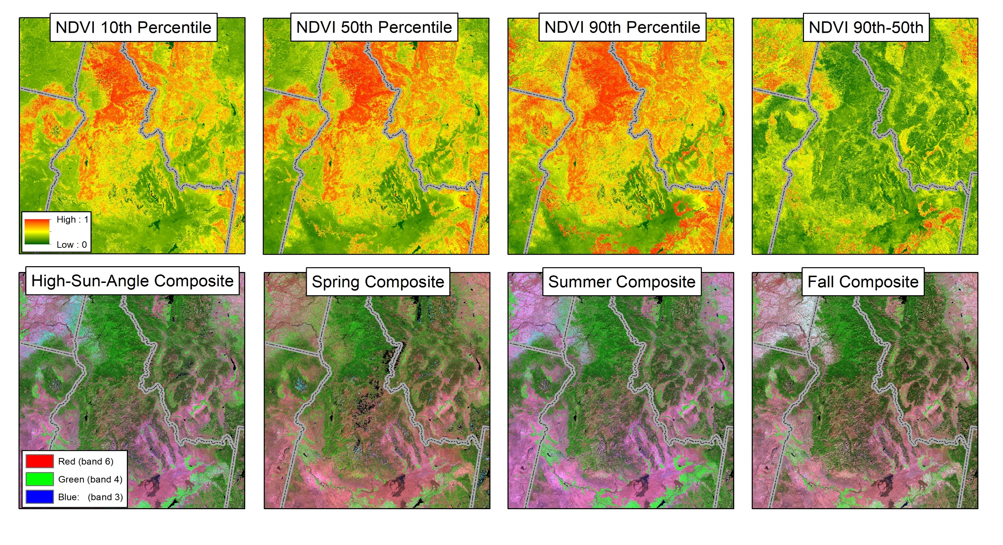
Percentile Composites
Notes:
Percentile composites – started at end of Remap – no manual clean-up needed – making all this feasible
Good composites – why we are focusing mostly on training to improve models
NDVI Short May 1 - Sept 30
NVDI Long March 1 – Oct 15
Winter - November 1 – April 15 (or January 1 – April 15 if you can’t span calendar year)
Spring - April 16 – June 30
Summer - June 16 – August 31
Fall - August 16 – October 31

Slide 10
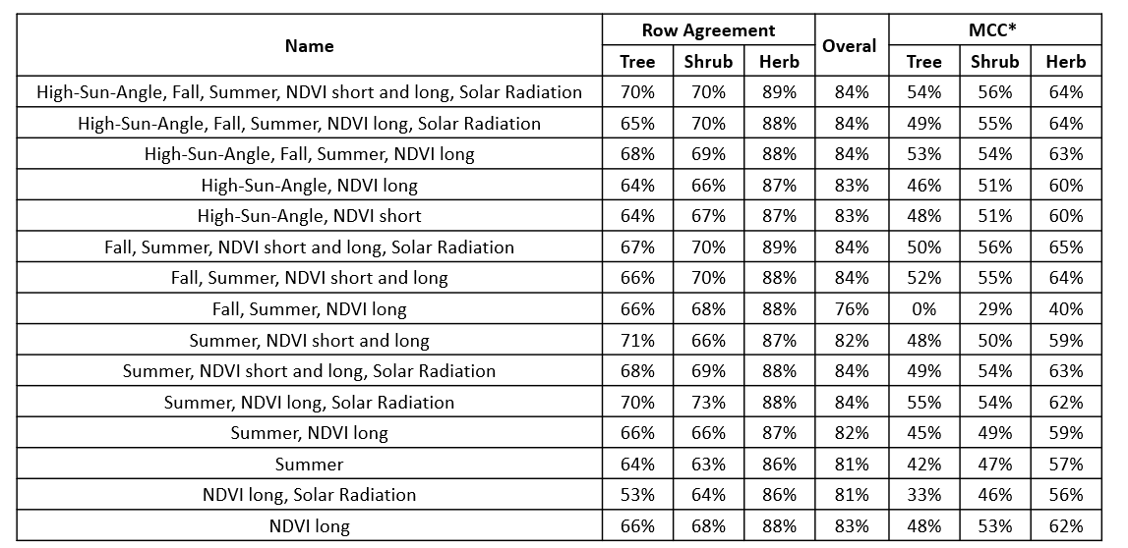
Disturbed Areas – different composites
* MCC = Matthew’s Correlation Coefficient
Note: all models generated with See5 trained with consensus map samples
Notes:
Results of different combination of image composites.
In general the more the better for overall agreement
We’ll probably stick with the seasonal composites and one NDVI for production

Slide 11
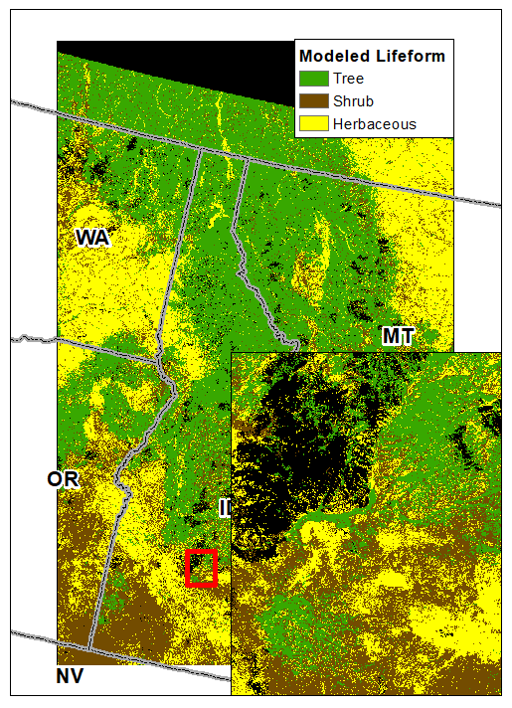
Lifeform Modeling
Outside Disturbances
Removed old field plots (pre-2000)
Manually labeled additional field plots
Added expert opinion plots based on aerials
Filtered field plots by consensus map
Added plots by consensus map sampling
Balanced plots by expected proportions in map
Assessed using 1,123 LCMAP reference plots
Notes:
Take what we have learned and try modeling all pixels, not just disturbed, to capture other changes.
Have more options for Agreement Assessment
- LFRDB plots
- LCMAP 2018 reference plots - Team of interpreters labeling landcover classes based on aerial interpretation

Slide 12
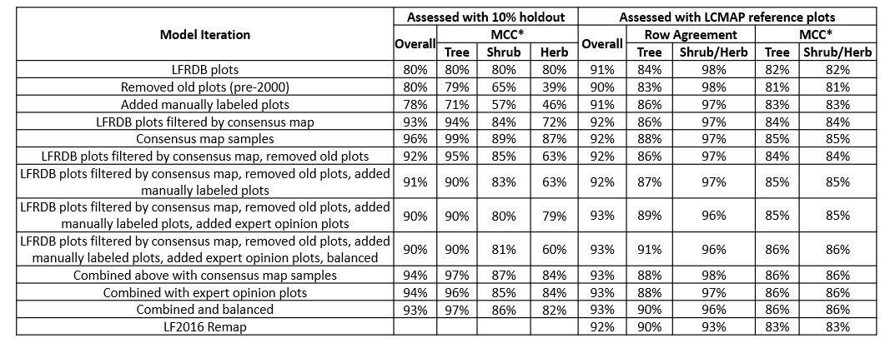
Lifeform Modeling in Non-Disturbed Areas
Note: all models generated with See5 using same image composites (high-sun-angle, tasseled cap, fall, summer, NDVI, and solar radiation)
* MCC = Matthew’s Correlation Coefficient
Notes:
Individual improvements combined for best results
Combined and balanced best overall model, but other models had better agreement for individual metrics
Remap was done mostly by expert opinion plots based on aerials, time-intensive and tailored to specific model results
With automated methods we are able to replicated portions of 4-year Remap in much less time – several months
As we compress the time to generate acceptable ML models, we can update and remap our base products more frequently with less latency.
More improvements with work of Josh Picotte – NEXT PRESENTATION
Next Steps:
Modeling cover and height using lidar
Inform fuel products
Expand to GeoArea – continue testing and developing methods for production scale

Slide 13
Thank you for listening
Check out landfire.gov

