Slide 1
LANDFIRE Disturbance
Mapping Disturbance for the Conterminous United States in Less than Six Months:
Exploring Improvements in Processing Power, Image Compositing, and Improved Change Detection Algorithms
Brian Tolk, Inga La Puma, Ray Dittmeier *
Sanath Sathyachandran​ **
* KBR, contractor to the USGS Center for Earth Resources Observation and Science (EROS), Sioux Falls, South Dakota
**AFDS, Contractor to the USGS
Work performed under USGS contract 40G02D0001
Notes:
Discuss

Slide 2
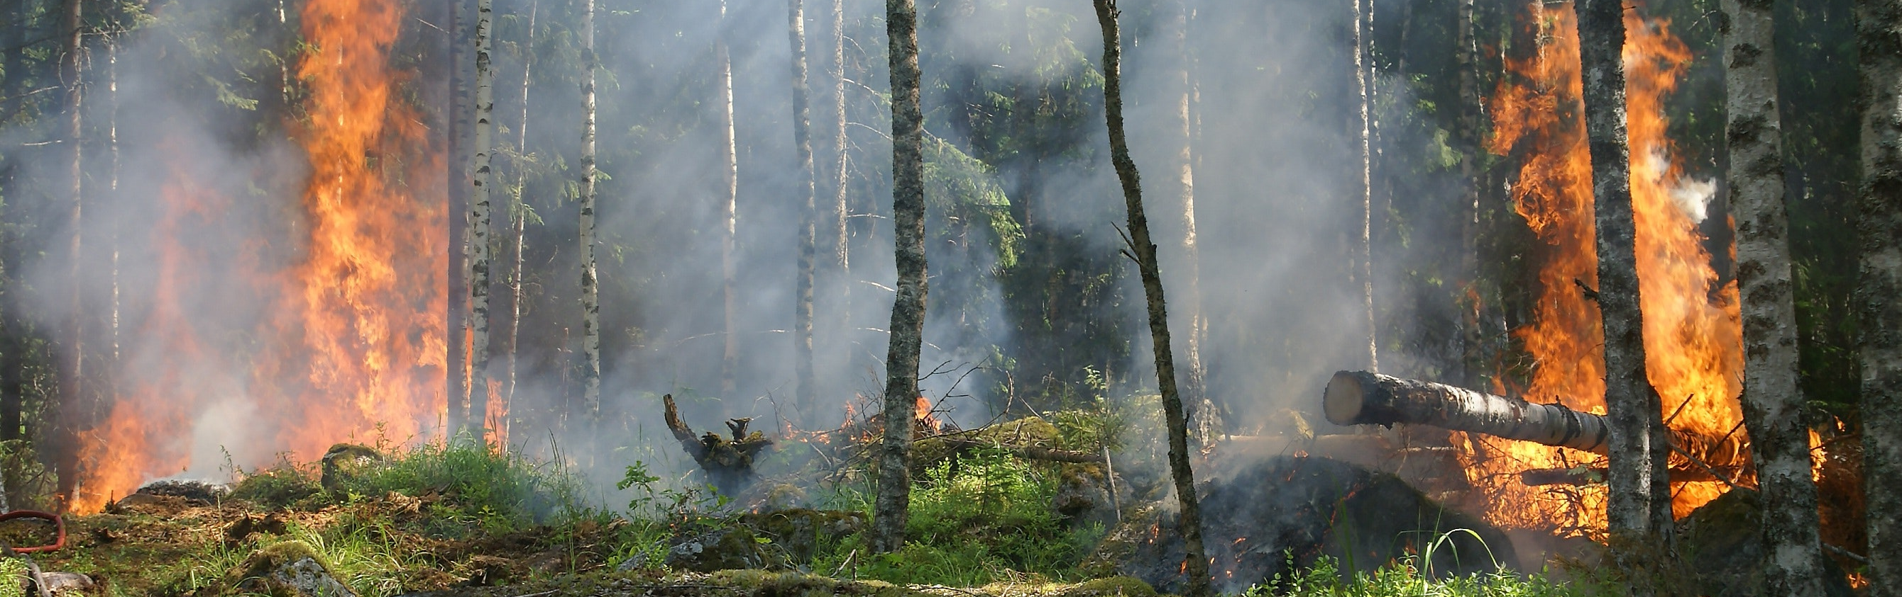

Topics
Brief history of LANDFIRE
The pieces of LANDFIRE Disturbance: data, products, and processes
Disturbance improvements over time: accelerating product releases without sacrificing accuracy
Notes:
Been mapping disturbance for 10 years – lots of changes

Slide 3
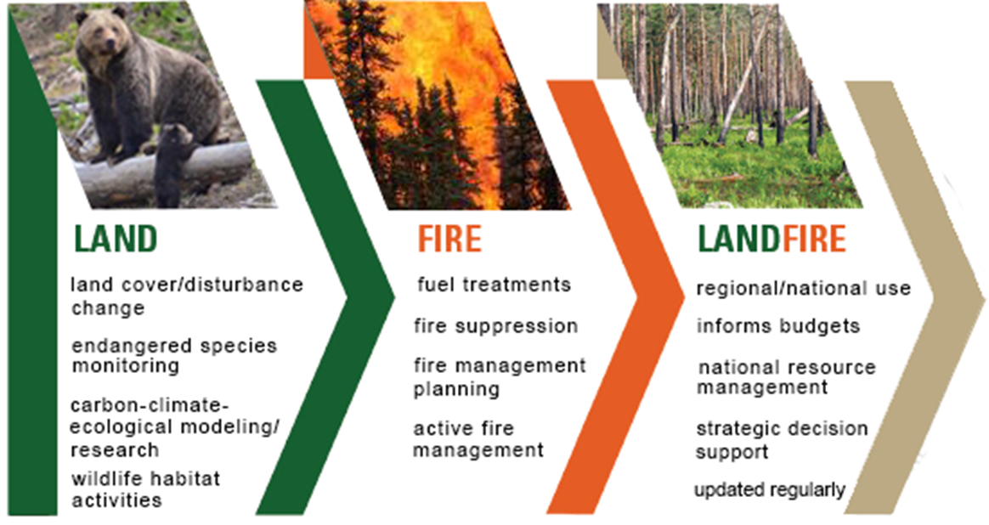




LANDFIRE at a Glance
Strategic and planning purposes
All-lands: CONUS, AK, HI, PR and other Insular Areas
Notes:
LANDFIRE is about land and fire. Both strategic and planning purposes.
National mapping program funded by USFS and DOI- office of wildland fire, TNC partners and USGS
Spurred by: National Fire Plan, Cohesive Strategy for fuel and fire management
LANDFIRE is a shared project between the DOI & Forest Service wildland fire management programs, sponsored by WFLC and produced by USGS, Forest Service, and TNC.
LANDFIRE is the USDA FS and US DOI program’s response to Congressional / GAO direction to produce consistent national inventory data for improving the prioritization of fuel projects and communities.
LANDFIRE helps managers improve planning and coordination. It has applications far beyond the wildfire community. LANDFIRE is a useful tool to help managers identify priority areas for projects to reduce wildfire risks and provide critical monitoring data. Managers will have better resource information enhancing management decisions related to ecosystem health in forest, shrub, and grass environments.

Slide 4
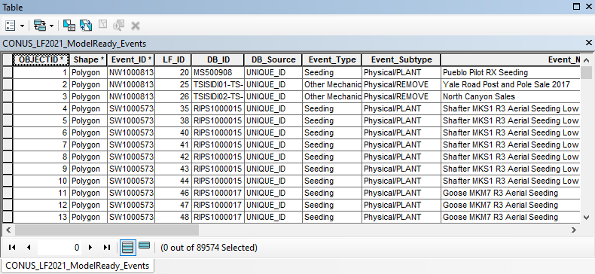
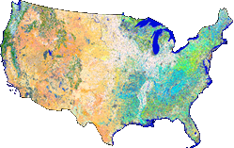
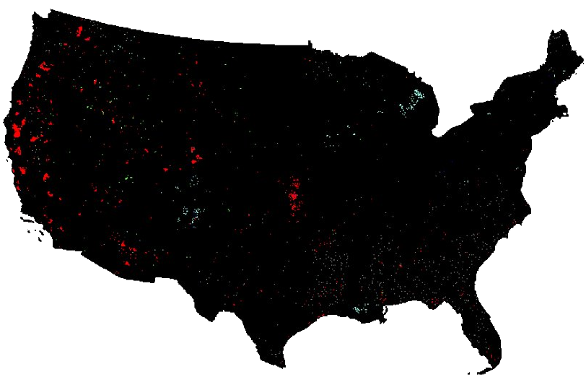
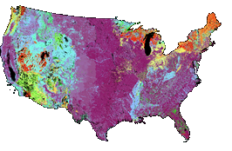
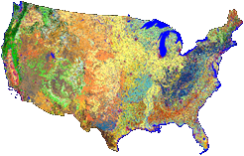
LANDFIRE Products
Reference
LF Reference Database
Public Events Geodatabase
Fuel
3 Anderson Fire Behavior Fuel Models
40 Scott and Burgan Fire Behavior Fuel Models
Forest Canopy Base Height
Forest Canopy Bulk Density
Forest Canopy Cover
Forest Canopy Height
Fuel Characteristic Classification System Fuel Beds
Fuel Vegetation Cover
Fuel Vegetation Height
Fuel Vegetation Type
Disturbance
Annual Disturbance
Historical Disturbance
Fuel Disturbance
Fire Regime
Fire Regime Groups
Mean Fire Return Interval
Percent Low-severity Fire
Percent Mixed-severity Fire
Percent Replacement-severity Fire
Succession Classes
Vegetation Condition Class
Vegetation Departure Index
Vegetation
Existing Vegetation Cover
Existing Vegetation Height
Existing Vegetation Type - Ecological Systems
Existing Vegetation Type - National Vegetation
Classification
Biophysical Settings
Notes:
How disturbance data feed into other products

Slide 5
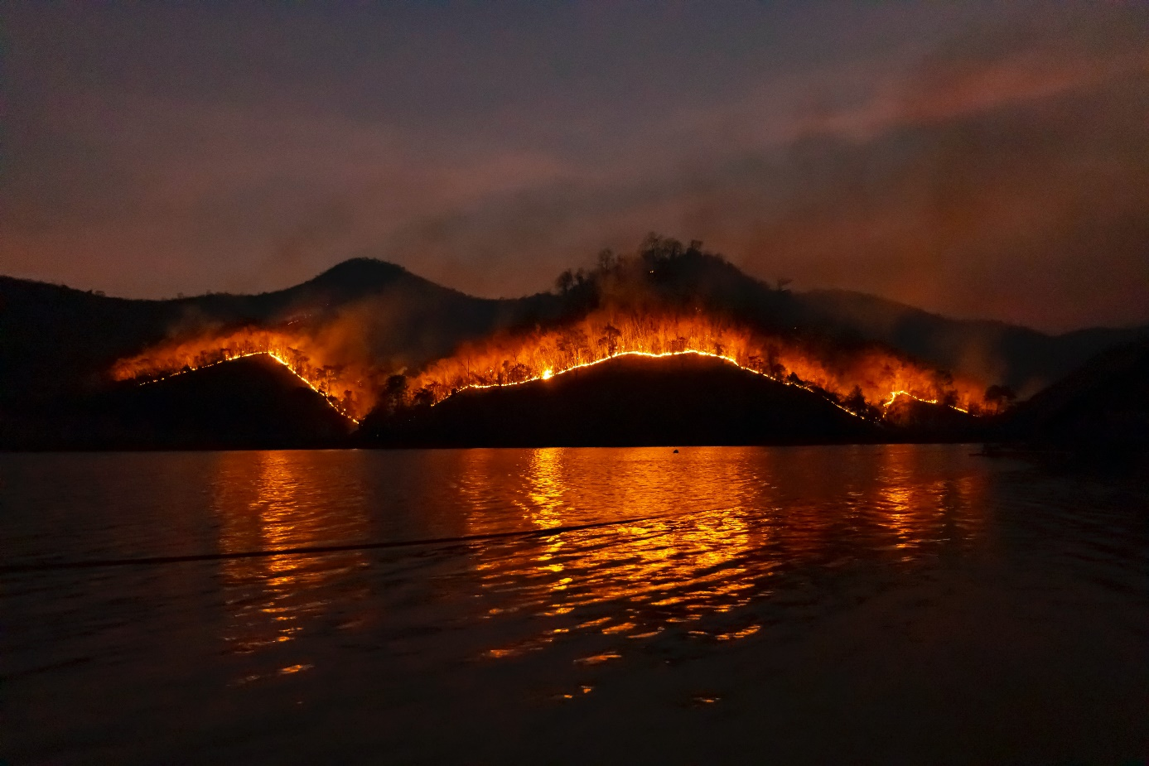
What is LANDFIRE Disturbance?
LANDFIRE’s disturbance products reflect abrupt inter-annual changes originating from either human or natural incidents but also include agency-submitted “Events” that capture vegetation/fuel treatment activity
Three key components
  Fire Program Data
    MTBS, BARC, RAVG
  Public Events (agency/user produced)
  Remotely Sensed Landscape Change (RSLC)
Other data/programs
  NLCD (Urban/Roads)
  GAP (Protected Areas)
  USDA (Cropland Data Layer)
Notes:
Read the fist bullet. And second bullets

Slide 6
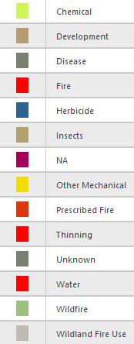
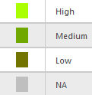
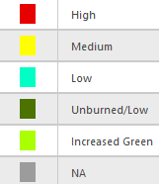
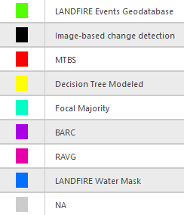
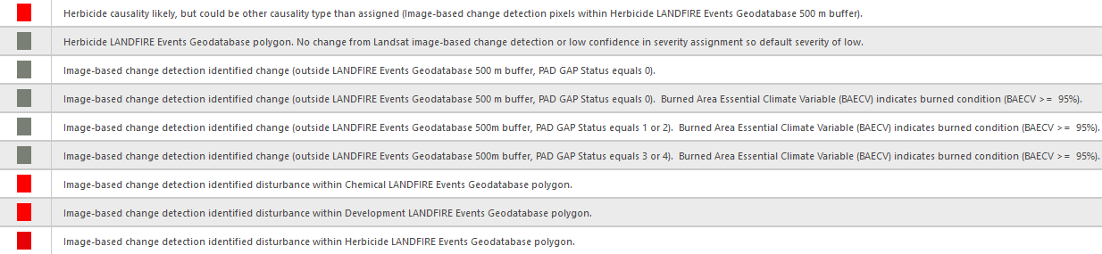
Disturbance Attributes
Dist Type
Dist Conf
Severity
Severity Conf
Sources (up to 4 per class)
56 Unique Class descriptions
Detailed Descriptions
Notes:
sfs

Slide 7
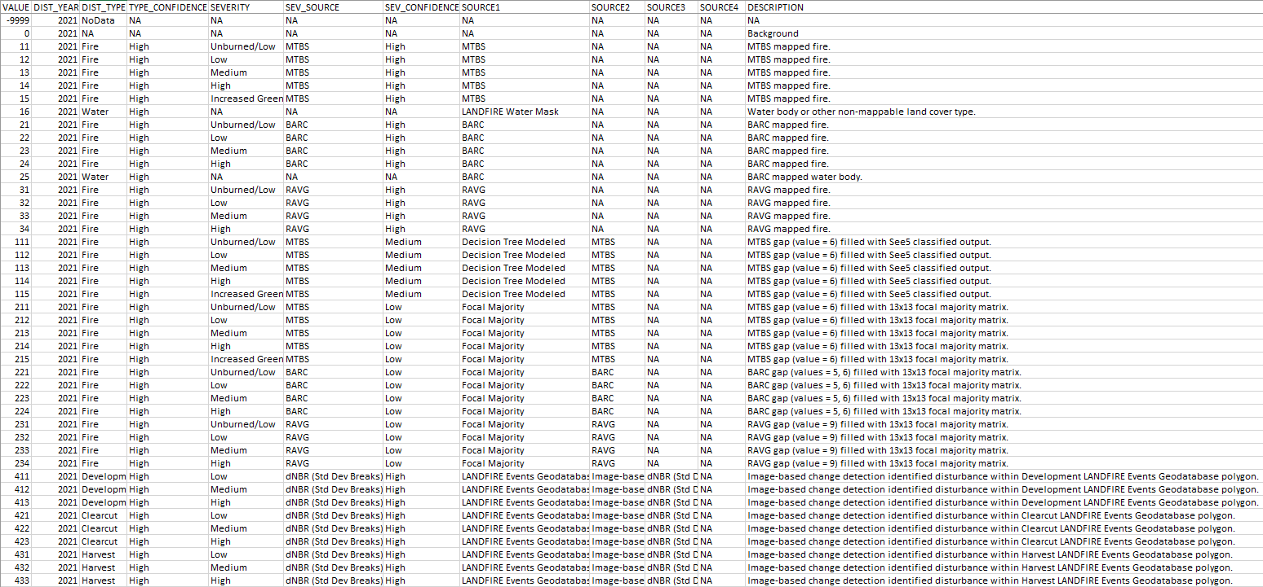
Annual Disturbance Legend
323 Unique Classes
Notes:
Allows users to sort and parse data a number of ways.

Slide 8
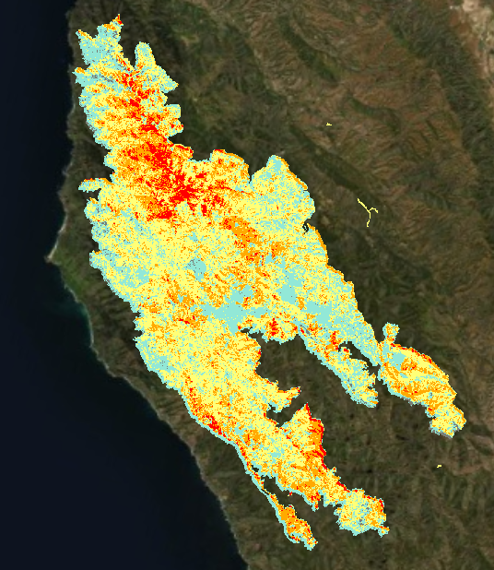
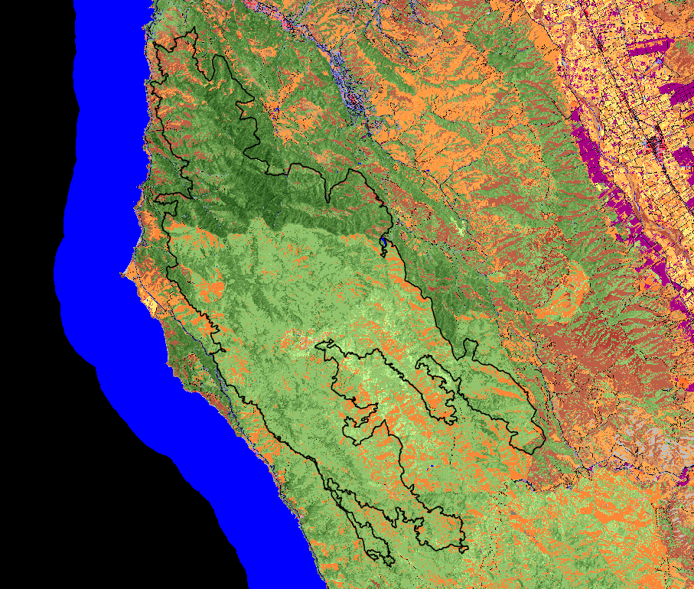
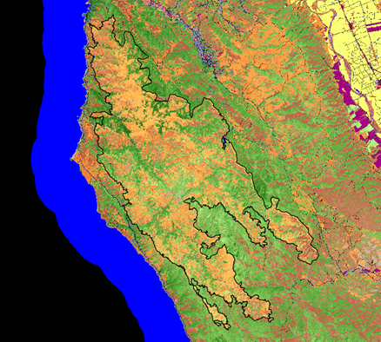
How LANDFIRE Disturbance Products are Used
Large Disturbance
Year: 2016
Type: Wildfire
Type Confidence: High
Severity: Low-to-high
Severity Source: MTBS
Severity Confidence: High
Existing Vegetation Cover
LF 204 Pre-Fire
Existing Vegetation Cover
LF 206 Remap Post-Fire

Slide 9
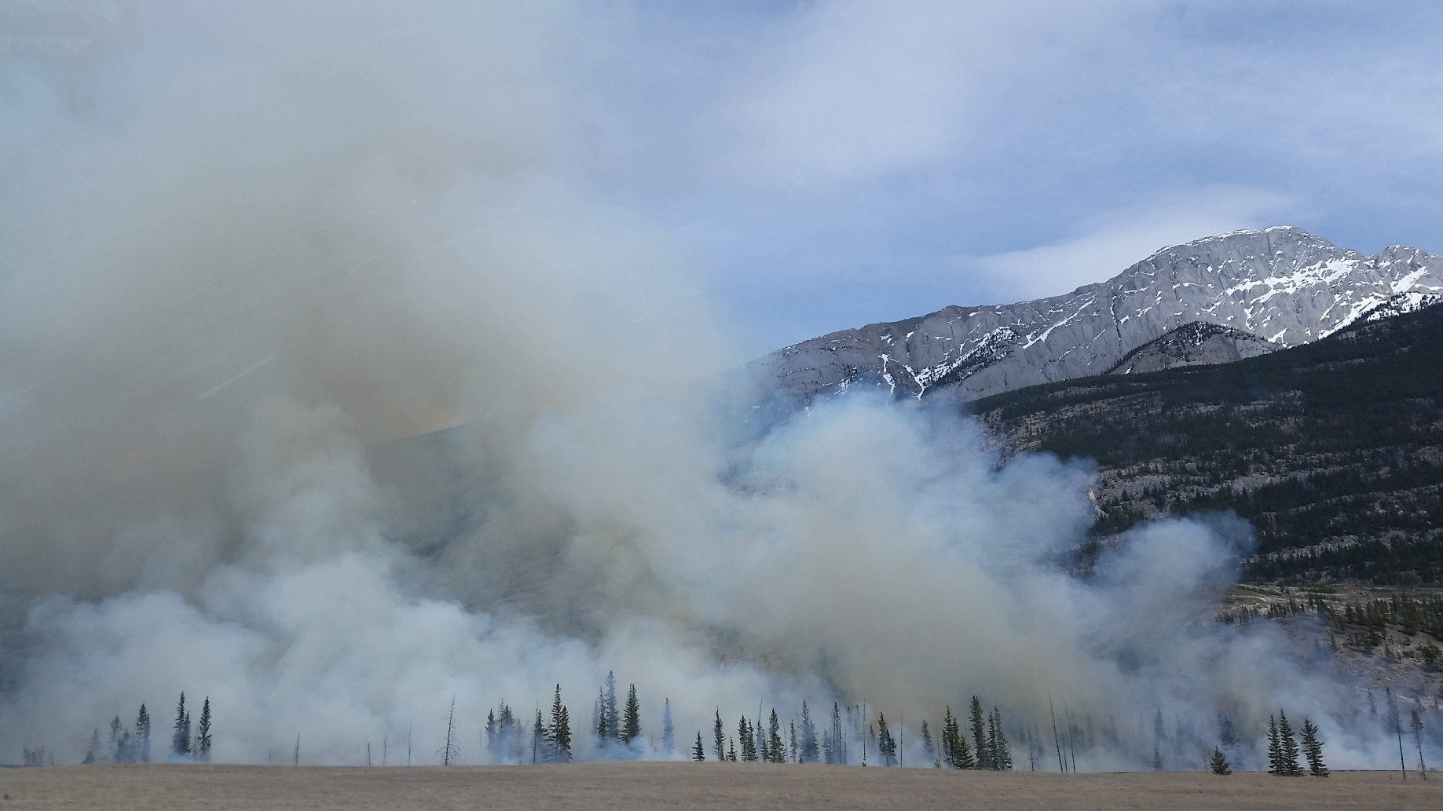
What’s Contributed to “Better/Faster” Disturbance Products?
Free and open access to the Landsat archive
Hardware
  Clustered computer processing
  High performance computing
  Cloud computing
Software Innovations
  Automation through scripting
  Improved compositing algorithms
    Percentile-based
  New change products
    SAFER
    Percentile MIICA
Improved Analyst Mapping
  Shared resources/knowledge
  Training resources
  Project management

Slide 10
Disturbance Processes and Changes Through Time
Years Mapped | Year Completed | Primary Change Detection Algorithm | Imagery Acquisition Method | Highlights
1999 – 2008 | 2011 | Vegetation Change Tracker (VCT) | Hand-Selected Scenes by WRS2 P/R | PC – Level Processing; Minimal Analyst Involvement
2008 – 2010 | 2013 | Multi-Index Integrated Change Analysis (MIICA) | Hand-Selected Scenes by WRS2 P/R | PC – Level Processing; Minimal Analyst Involvement
2011 – 2012 | 2015 | MIICA | Image Compositing (Best Pixel) based on LF Tiling Scheme | Processed Imagery on EROS-Cluster System (No Landsat 5); Analyst-Driven Mapping
2013 – 2014 | 2017 | MIICA | Image Compositing (Best Pixel) - LF Tiling Scheme | Combined Cluster System and ESPA (SR replaces TOA)
2015 – 2016 “Remap” | 2021 | MIICA | Image Compositing (Best Pixel) - LF Tiling Scheme | Best Pixel Compositing Method Improvements (Scene Priority)
2017 – 2020 | 2022 | MIICA/pMIICA/Spatially Adaptive Filter for Error Reduction (SAFER)​ | Image Compositing (90/50/20 Percentiles) - LF Tiling Scheme | USGS HPC (Denali) Comes On-Line; Staff increases
2021 - 2022 | 2023 | MIICA/pMIICA/SAFER | Image Compositing (90/50/20 Percentiles) - LF Tiling Scheme | Mapped One Year (2021) in Six Months
2023 | 2024 | TBD | AWS Cloud Computing | More Data, Faster Processing, New Techniques

Slide 11
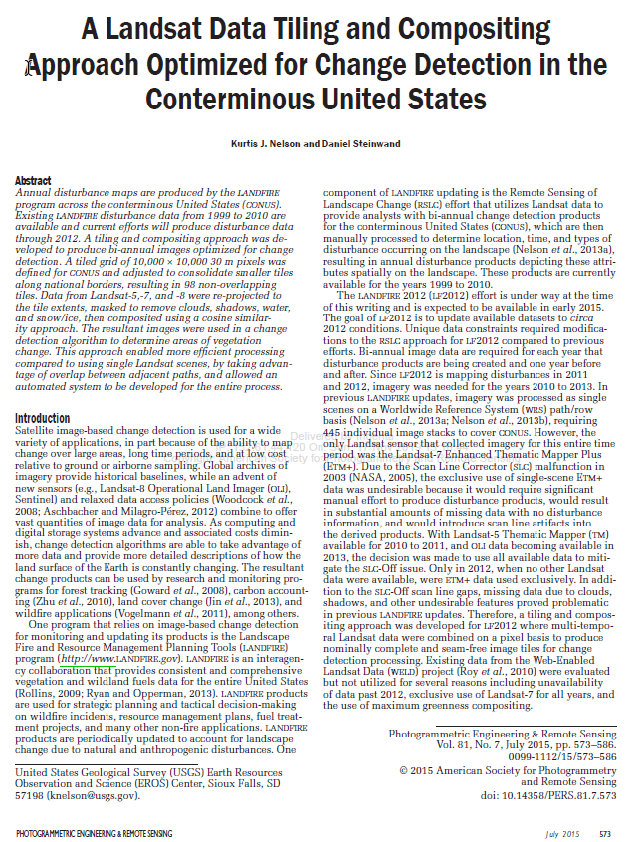
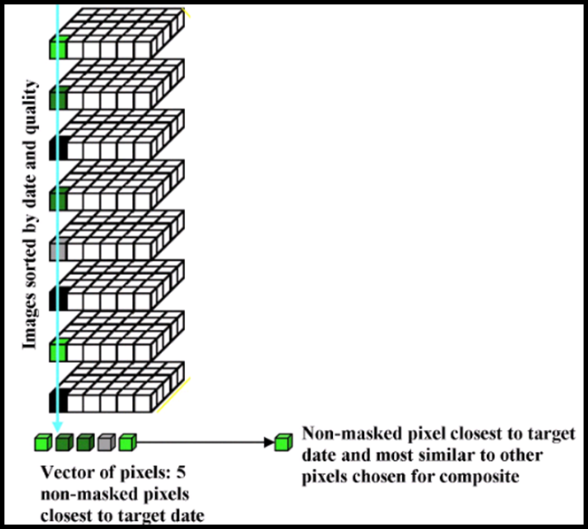
Initial Compositing Algorithm - Best Pixel
Kurtis Nelson and Dan Steinwand
Based on target dates
DOY 175 (early) and DOY 250 (late)
Notes:
Based on target dates.

Slide 12
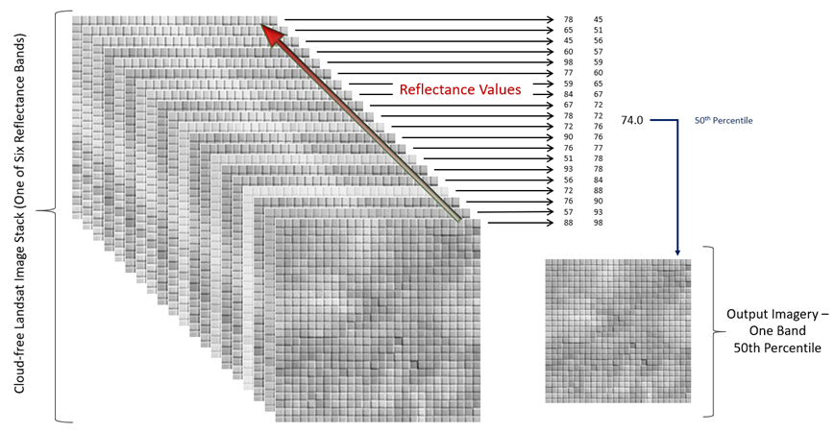
Percentile Composite
Notes:
Mention how many scenes on average there are. Can be as many as possible.

Slide 13
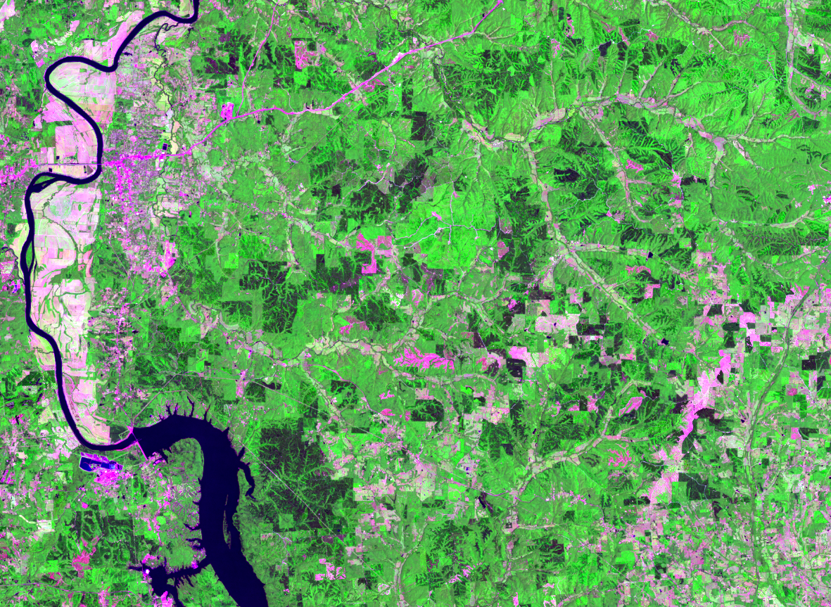
Percentile Composite
Percentile-based composites have proven to be qualitatively superior to best-pixel composites
Tend to be less “clustered” and pixelated (reduces the likelihood of outliers)
Tile boundaries and WRS path/row seam lines are less pronounced
The key to a good composite is to have enough representative imagery for the dates of interest and effective cloud and shadow masking

Slide 14
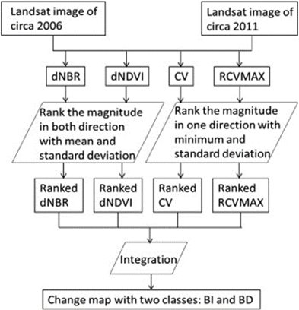
Change Products
For each compositing process 76 products are produced. These are distilled into a handful of change products and severity data that are leveraged by the analysts during the mapping process
A few of the primary products used are:
  MIICA (Multi-Index Integrated Change Analysis)
  dNBR (pre/post burn index)
  dNDVI (pre/post vegetation index)
  dNDMI (pre/post moisture index)
MIICA
Jin, et. al 2011
Notes:
Tools in our toolchest

Slide 15
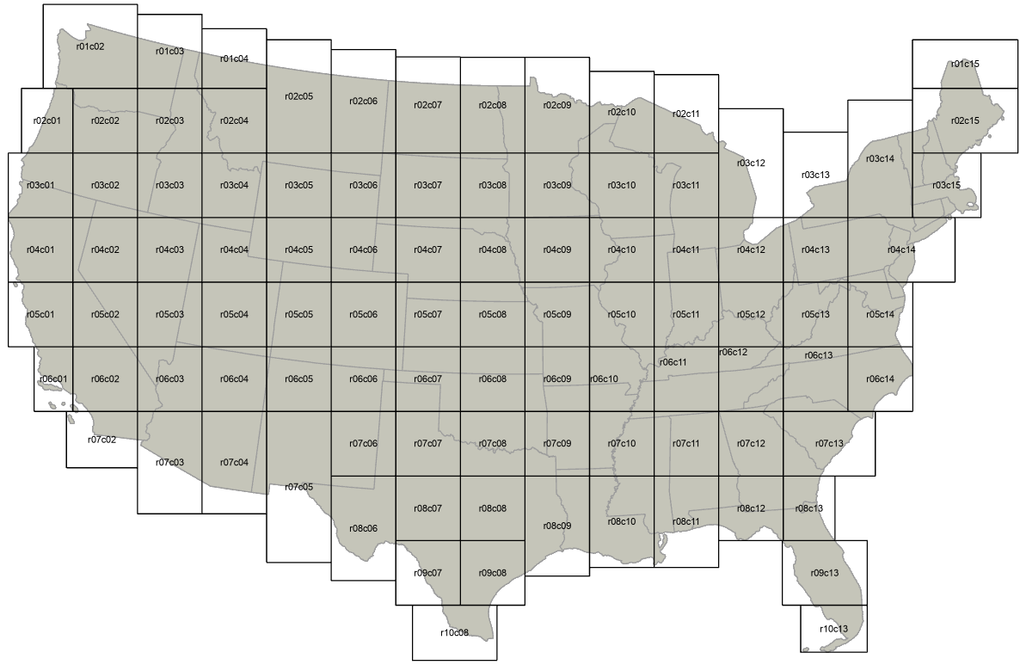
Examples

Slide 16
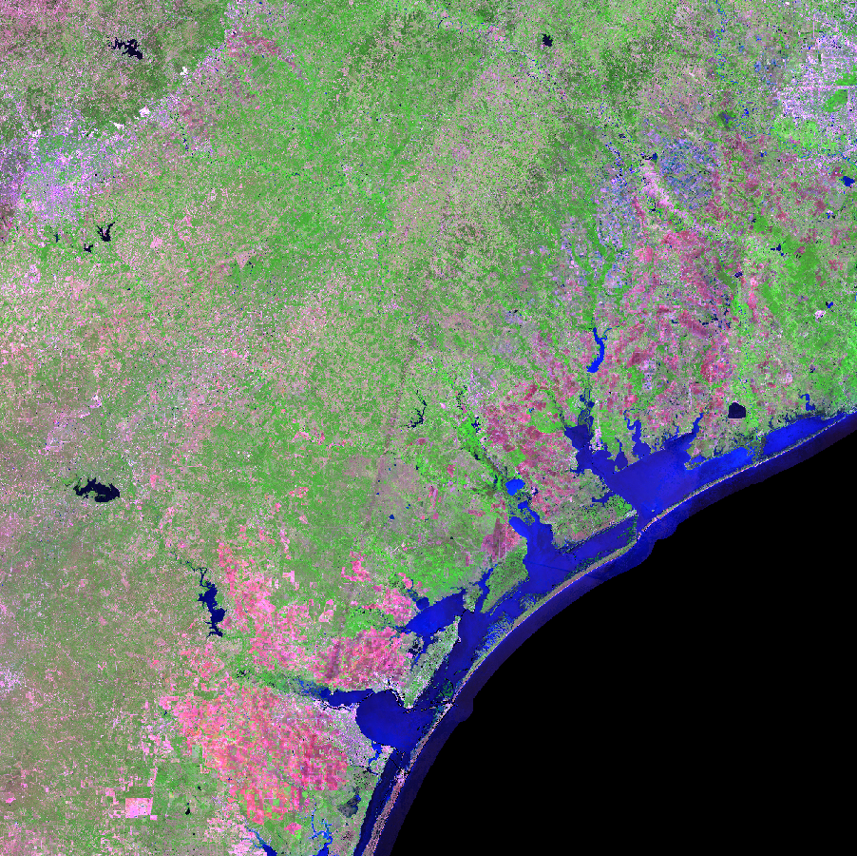
MIICA Examples
50th percentile composite 2019 (early season)
Notes:
2019 175

Slide 17
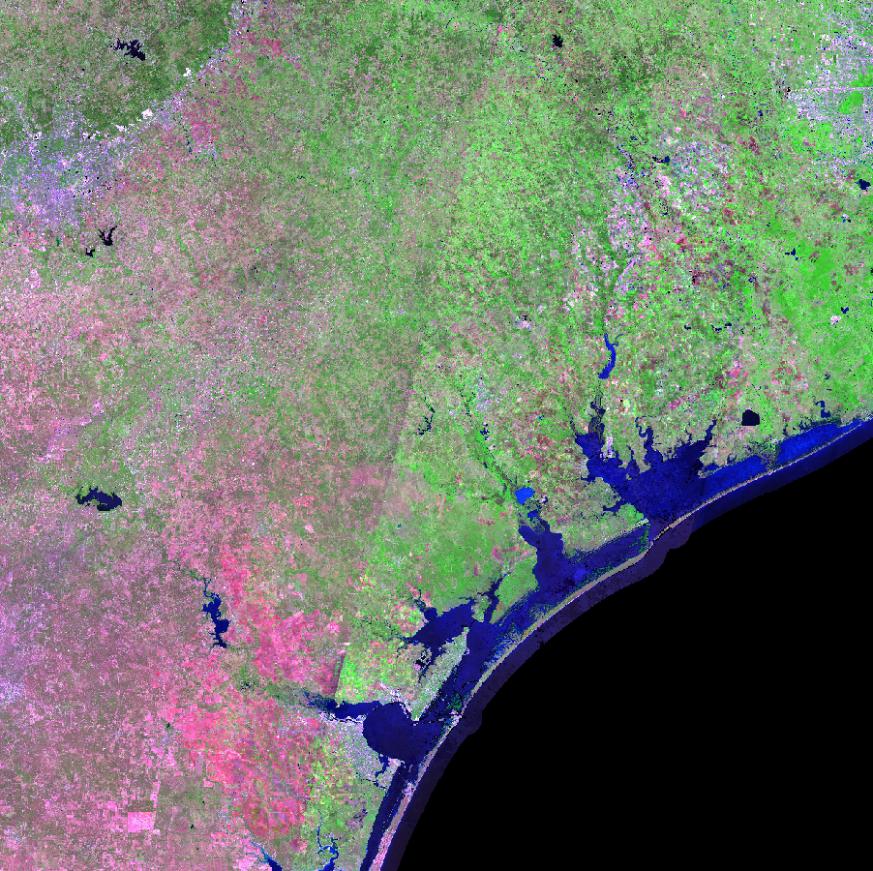
MIICA Examples
50th percentile composite 2020 (early season)
Notes:
2020 175

Slide 18
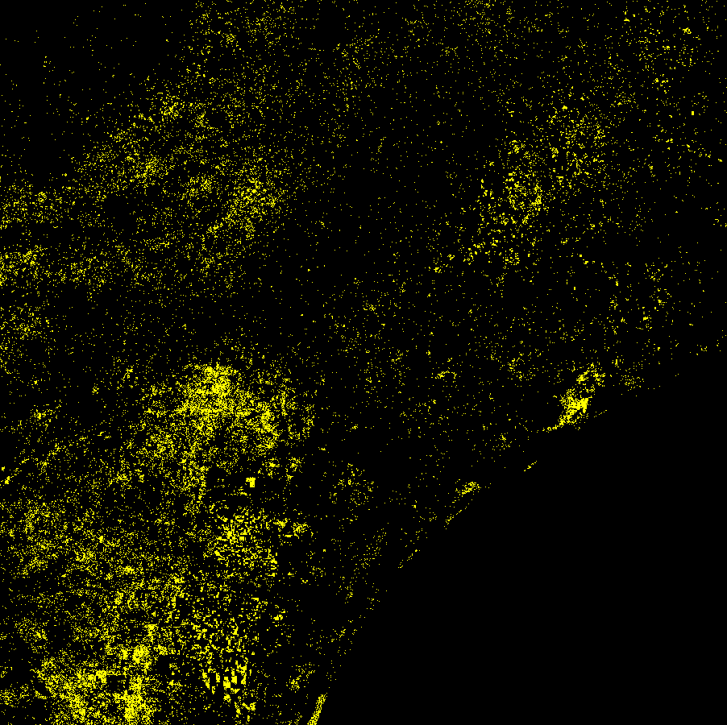
MIICA Examples
MIICA 2019 – 2020 (early season) produced from the 50th percentile composite

Slide 19
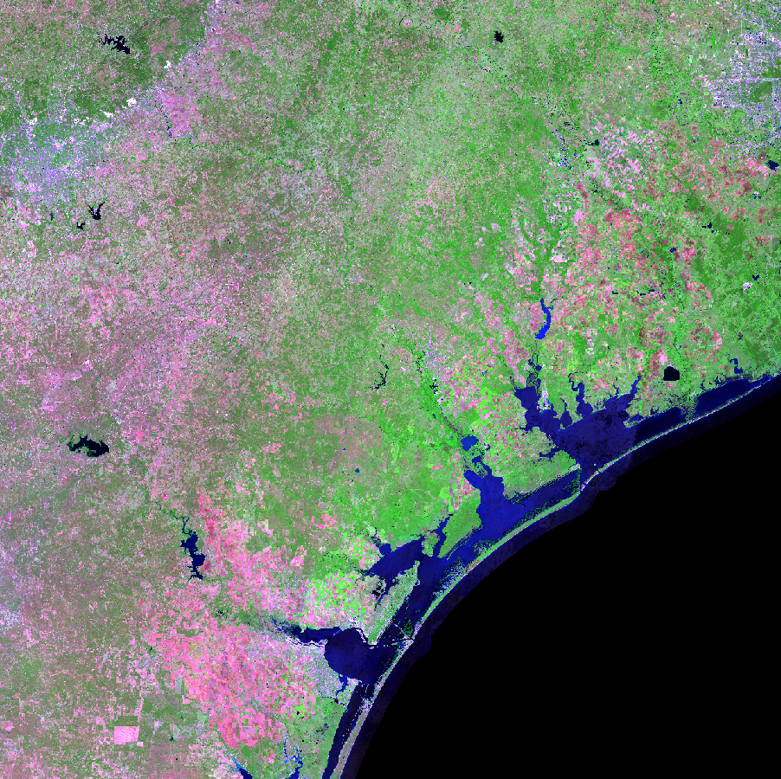
MIICA Examples
50th percentile composite 2019 (late season)

Slide 20
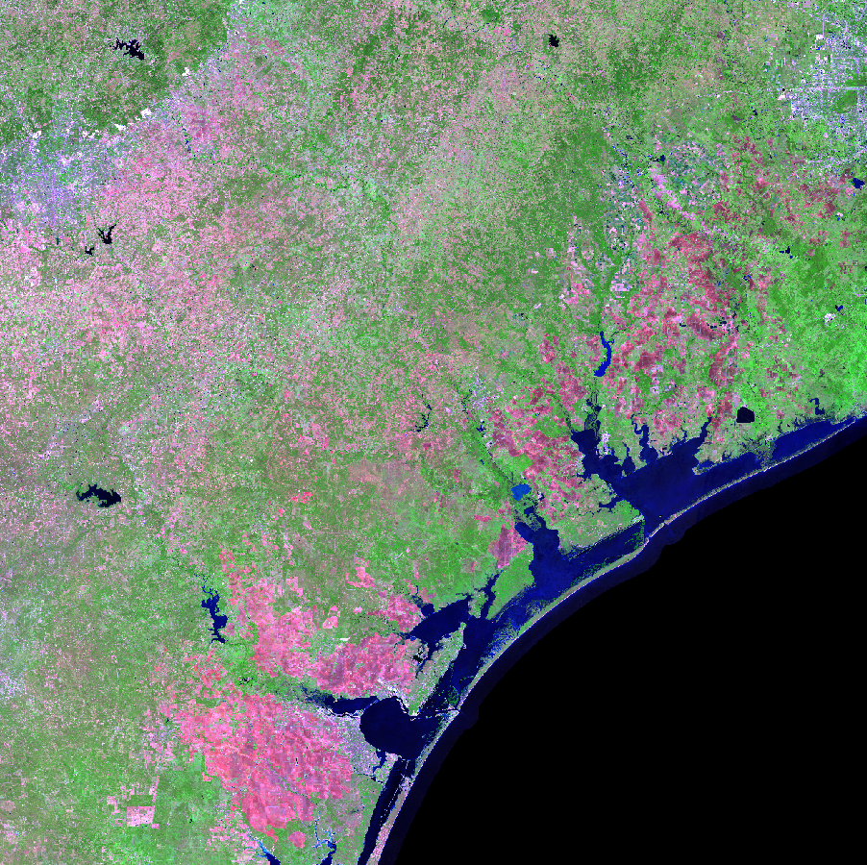
MIICA Examples
50th percentile composite 2020 (late season)

Slide 21
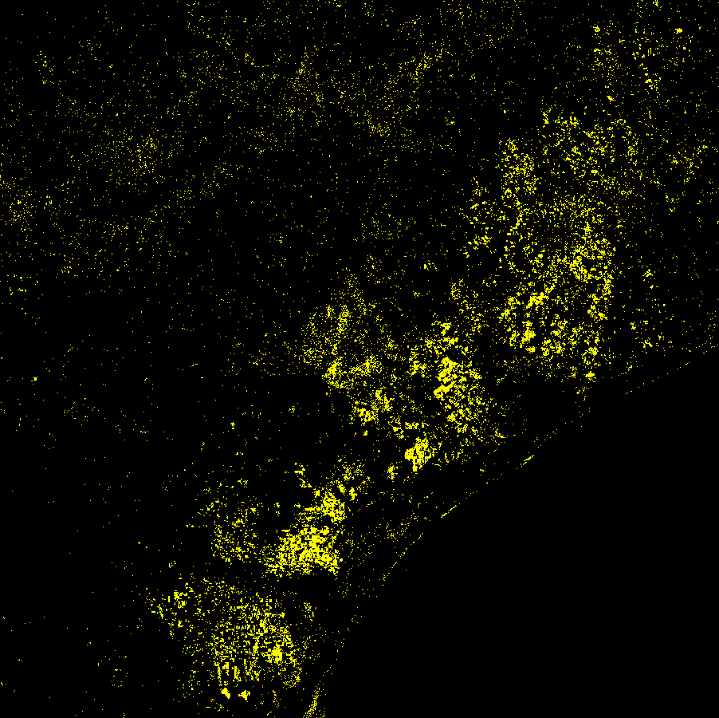
MIICA Examples
MIICA 2019 – 2020 (late season) produced from the 50th percentile composite

Slide 22
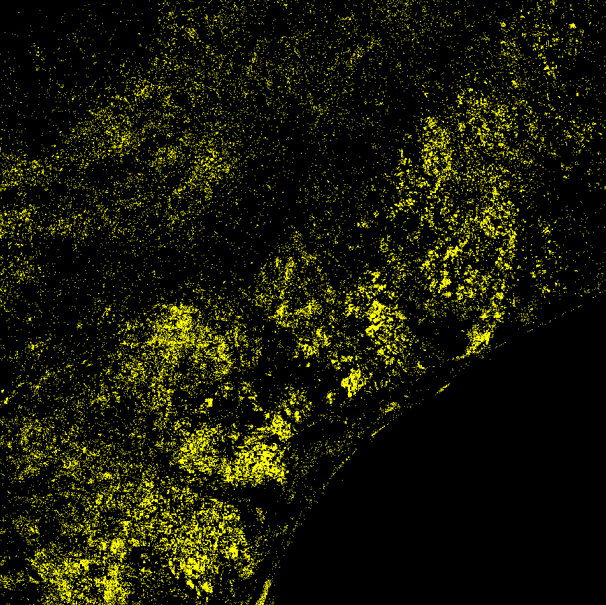
MIICA Examples
MIICA 2019 – 2020 (early and late season) produced from the 50th percentile composite
This demonstrates how difficult it can be to tease out real or more permanent change from change that is either seasonal or due to temporary wet or dry conditions
Analysts use their skills of image interpretation along with corresponding imagery and change products to help sort through the noise

Slide 23
MIICA Examples
50th percentile composite 2020 (late season)
For a more specific example let’s zoom in

Slide 24
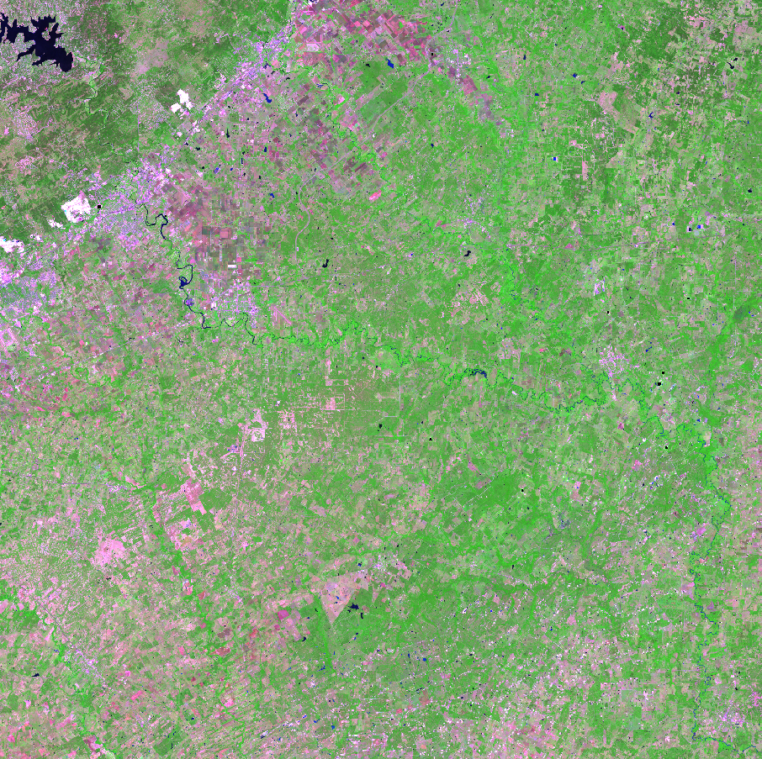
MIICA Examples
50th percentile composite 2019 (early season)

Slide 25
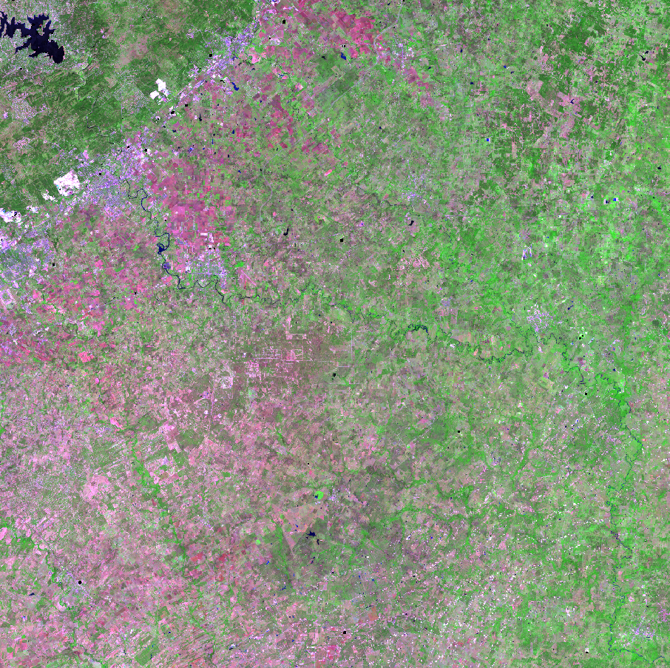
MIICA Examples
50th percentile composite 2020 early season composite
Notice the seasonal change in the SW portion of the image

Slide 26
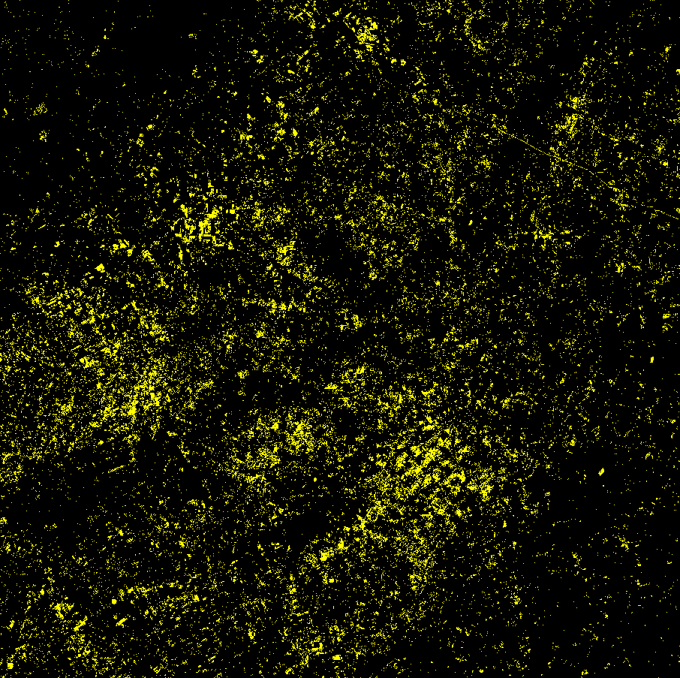
MIICA Examples
MIICA 2020 for early and late seasons

Slide 27

Percentile MIICA
The percentile MIICA product distills all individual MIICA products (12 total) into a single product by analyzing combinations data and assigning a value according to the number of times a pixel is identified as changed
Provides a scale of values 1-10 with 10 being the most likely change value. This gives the analyst the ability to adjust the cutoff to what’s perceived as real change
Here everything with a value of 5 or greater is displayed
Notes:
Used pMIICA to reduce the “noise"

Slide 28
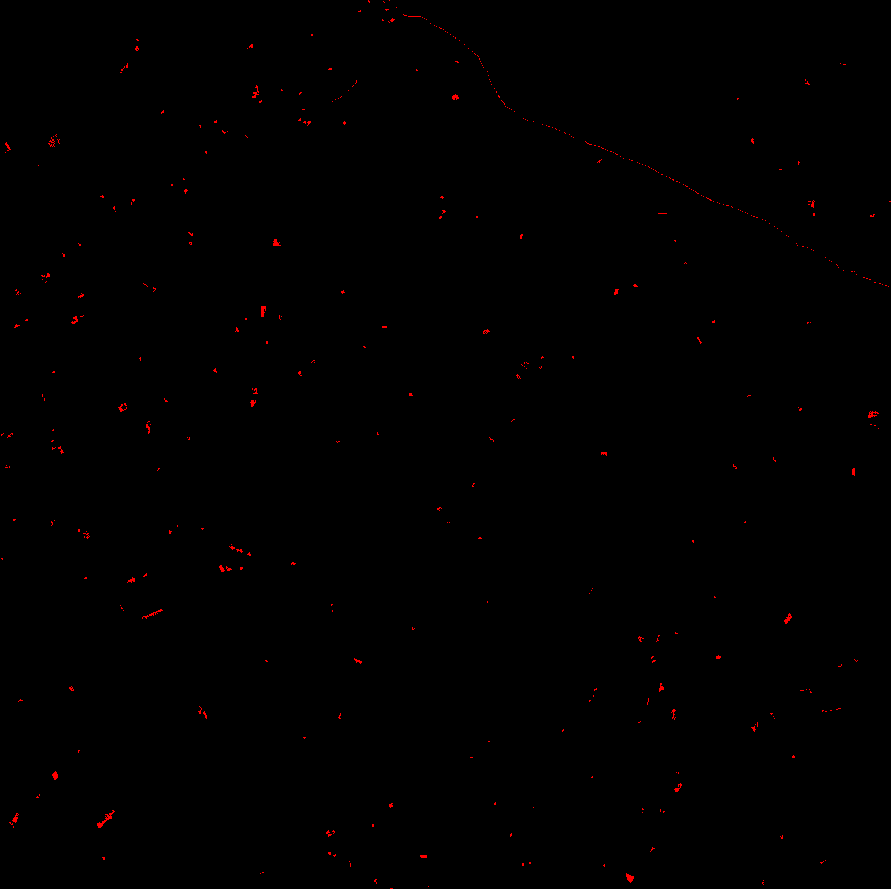
Percentile MIICA
This is the final mapped disturbance after analysts edits. There is a high correlation between the final output and pMIICA product
In areas of disagreement with pMIICA the analysts visually identified change that wasn’t captured or used another data set to identify it (preponderance of evidence)

Slide 29

Spatially Adaptive Filter for Error Reduction (SAFER)​
Developed by the LANDFIRE research team
Uses spatial context, statistical evaluation, and random forest modeling to target disturbances
Algorithm details coming in the next presentation

Slide 30
SAFER and pMIICA
pMIICA
Using the previous examples, we can compare pMIICA to SAFER

Slide 31

SAFER and pMIICA
SAFER
There are a lot of similarities between the two products, but SAFER typically does a better job at removing some of the extraneous noise

Slide 32
SAFER and pMIICA
Final Disturbance

Slide 33
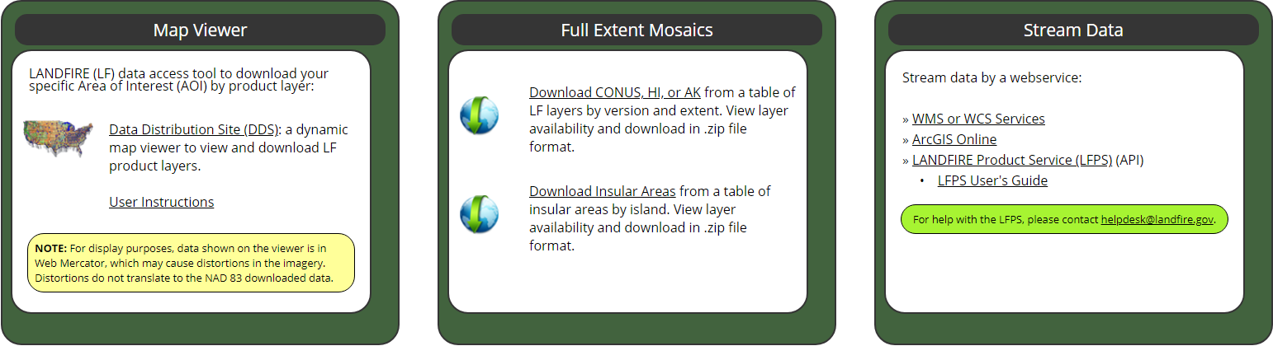
Conclusions
LANDFIRE is transitioning from mapping disturbance for the US and territories in two-year intervals (with a two-year delay) to mapping in approximately six months after imagery are collected
The combination of technological advancements, algorithm improvements, automation, and experienced staff are the primary components to achieving this goal
Other programs that are transitioning to cloud and high-performance computing, may be positioned to incorporate some of the process shared here
Notes:
Our data may someday be in the cloud.

Slide 34
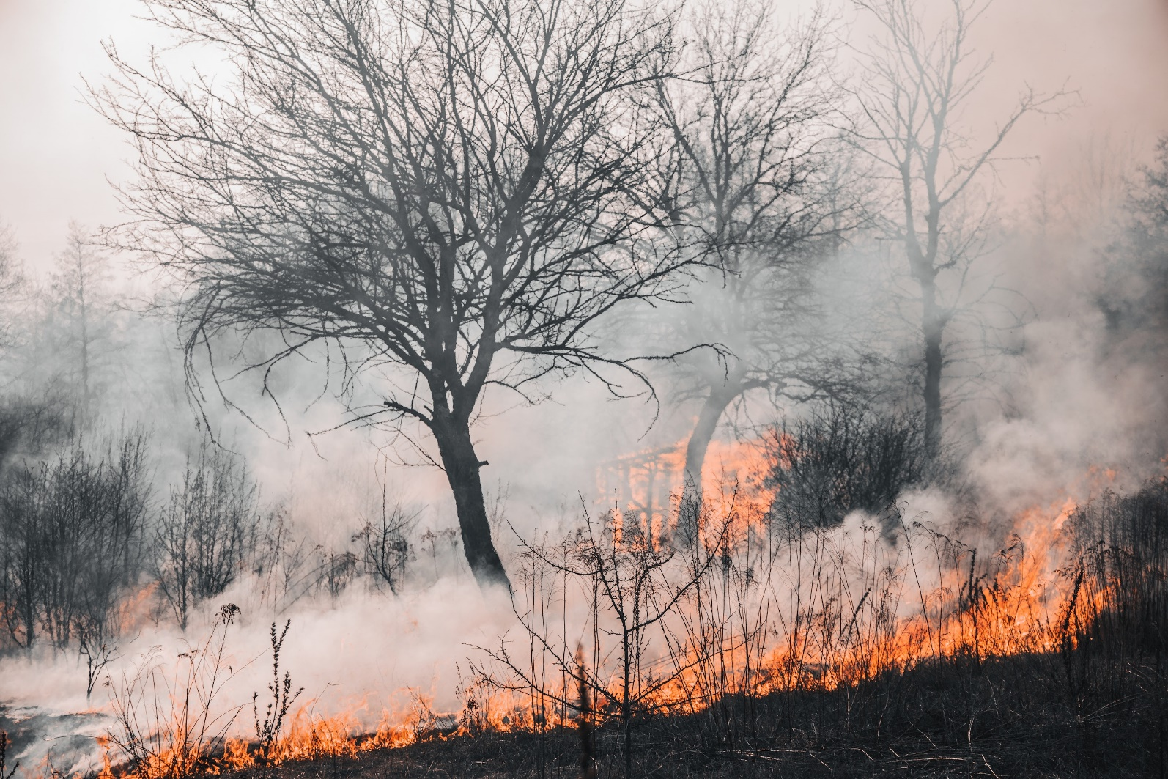
What’s Next?
Better composites (more imagery)
Cloud processing (significantly faster – no downloads)
Revamped legend with better attribution

Slide 35
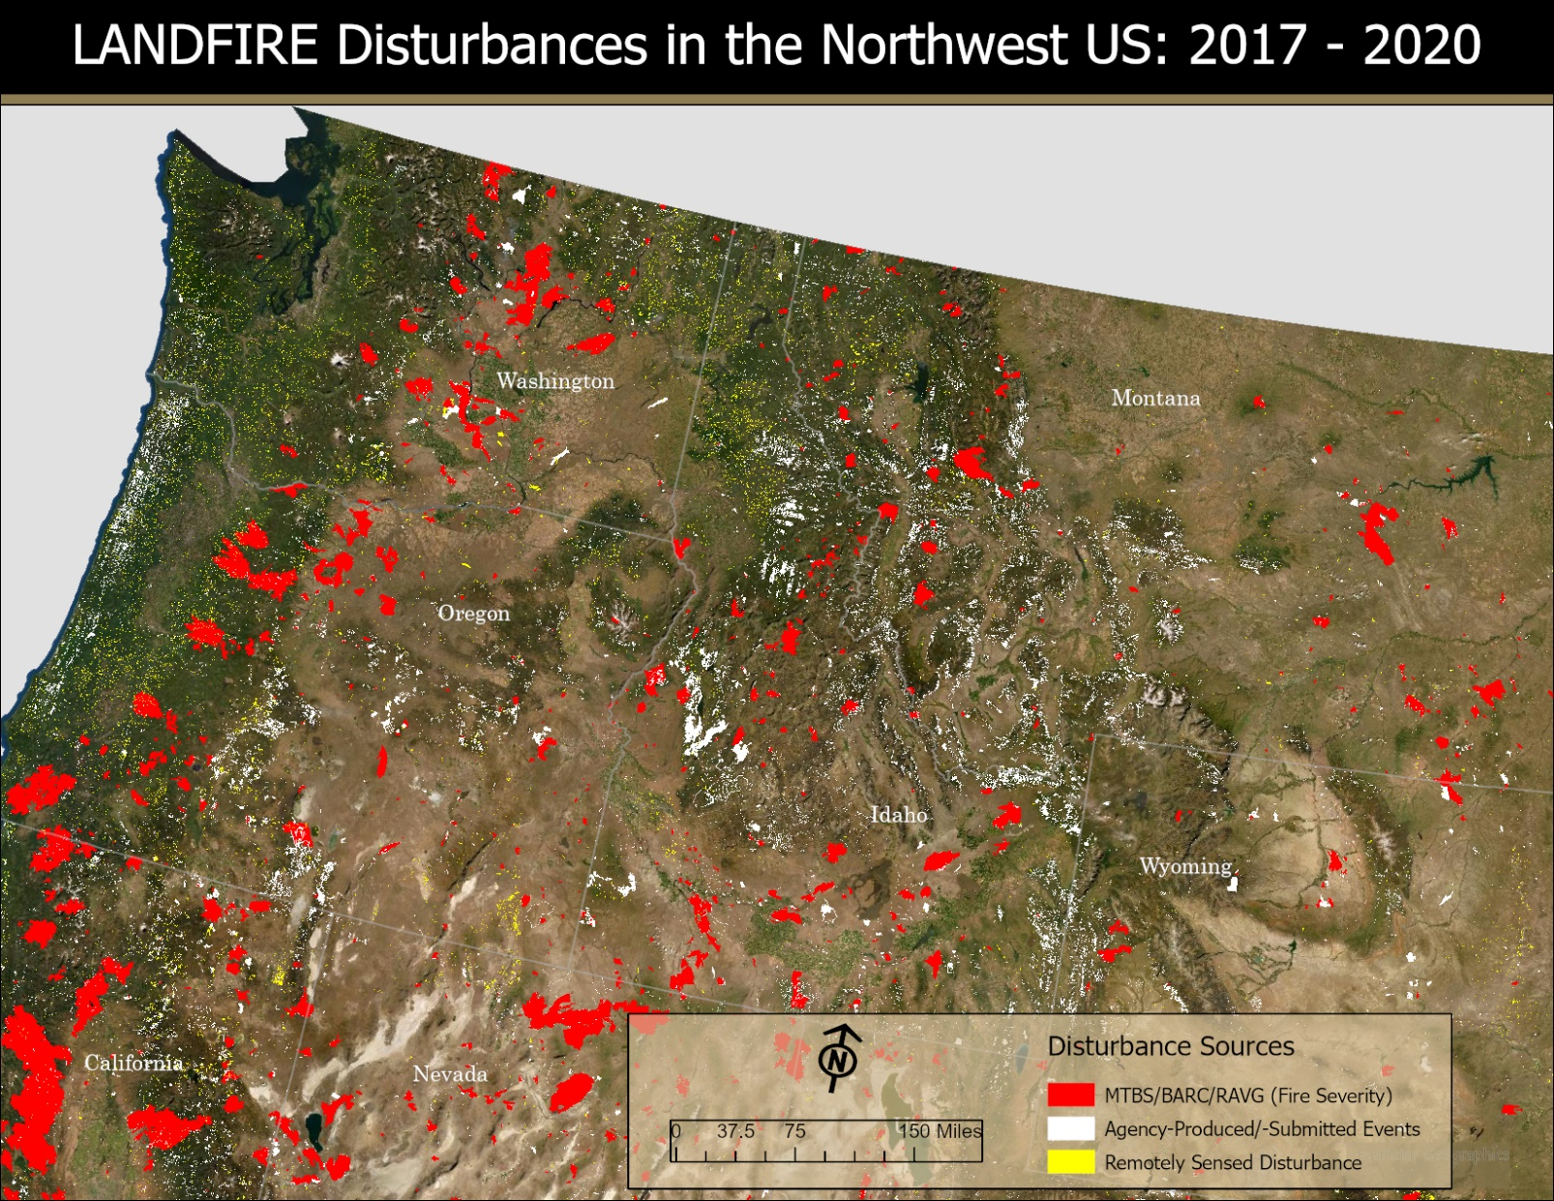
Thank You

